Slide 1
«Update sur les pathologies induites par les HPV oncogènes et non oncogènes au-delà du col de l’utérus»
Docteur Magali Flamme
Dermatologie
Pathologies des muqueuses
Bruxelles, Wavre, Charleroi

Slide 2


Slide 3
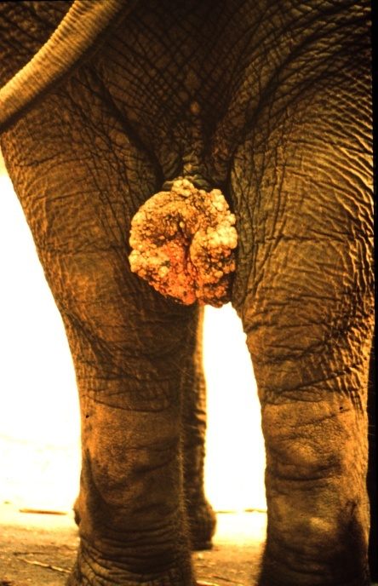
HPV ?
Famille: Papillomavirus
Tropisme pour les épithéliums squammeux
Chaque animal a son propre HPV
Courtesy Ian Frazer
Notes:
HPVs previously belonged to the sub-family Papillomavirus (together with Polyomaviridae) of the Papovaviridae family (all are tumour viruses as they can immortalise normal cells). In the past year, papillomaviruses have been formally recognised as a family of their own.⁸
There are two critical aspects of papillomaviruse biology. Firstly they have an absolutely restricted host range, only human papillomaviruses (HPV’s) infect humans, dog papillomaviruses only infect dogs and other canines and so forth. Secondly they show an exquisite tissue tropism such that only differentiated squamous epithelium will support the complete infectious cycle and the production of infectious particles. Because of this HPV’s cannot be propagated in tissue culture, few virus particles can be isolated from lesions and significant amounts of well characterised HPV antigens have not been generally available.
Human papillomaviruses (HPVs) are a family of small DNA viruses consisting of over 150 related genetic types, of which more than 85 are fully sequenced. The genome is encapsidated in an icosahedral protein coat, and there is no membrane envelope. The HPVs are rather closely related through phylogenetic and biological properties to the animal papillomaviruses, which are host-specific to other vertebrates including amphibians, reptiles, birds and a variety of land and sea mammals. HPVs do not infect any other species, nor do any of the animal papillomaviruses infect humans.
Occur in most mammals and birds (except Lab mice)

Slide 4
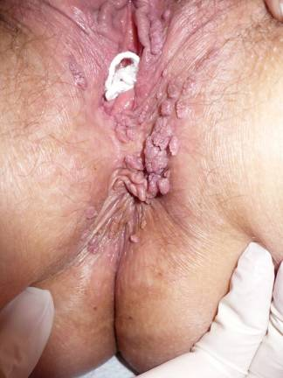
1.a. Lésions bénignes verruqueuses
Types de lésions

Slide 5
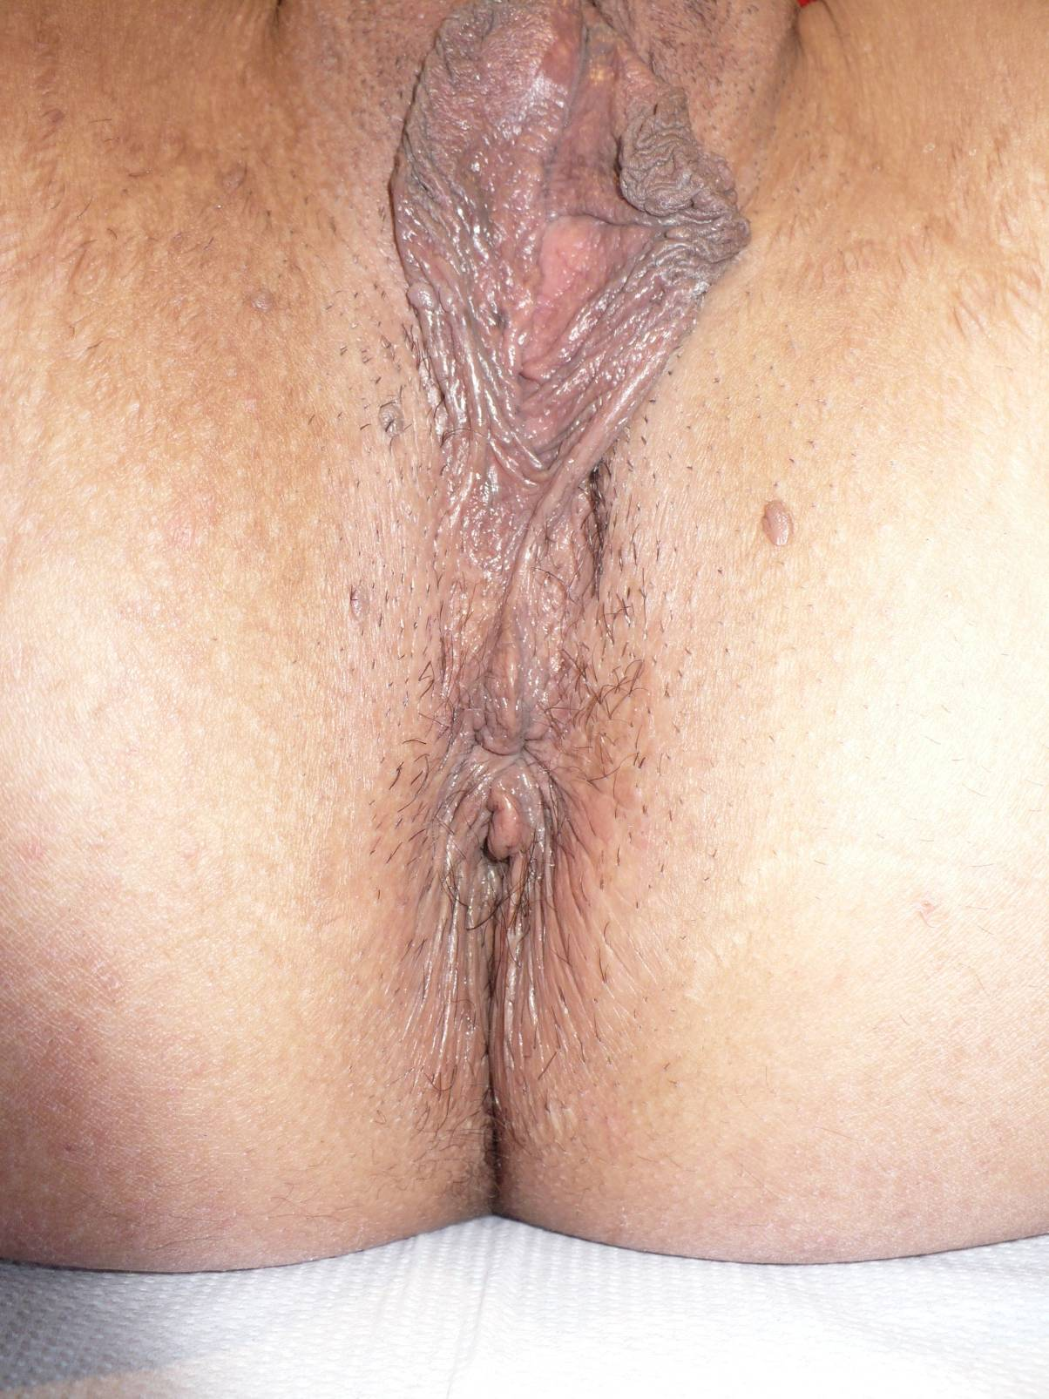
1.a. Lésions bénignes verruqueuses
Types de lésions

Slide 6
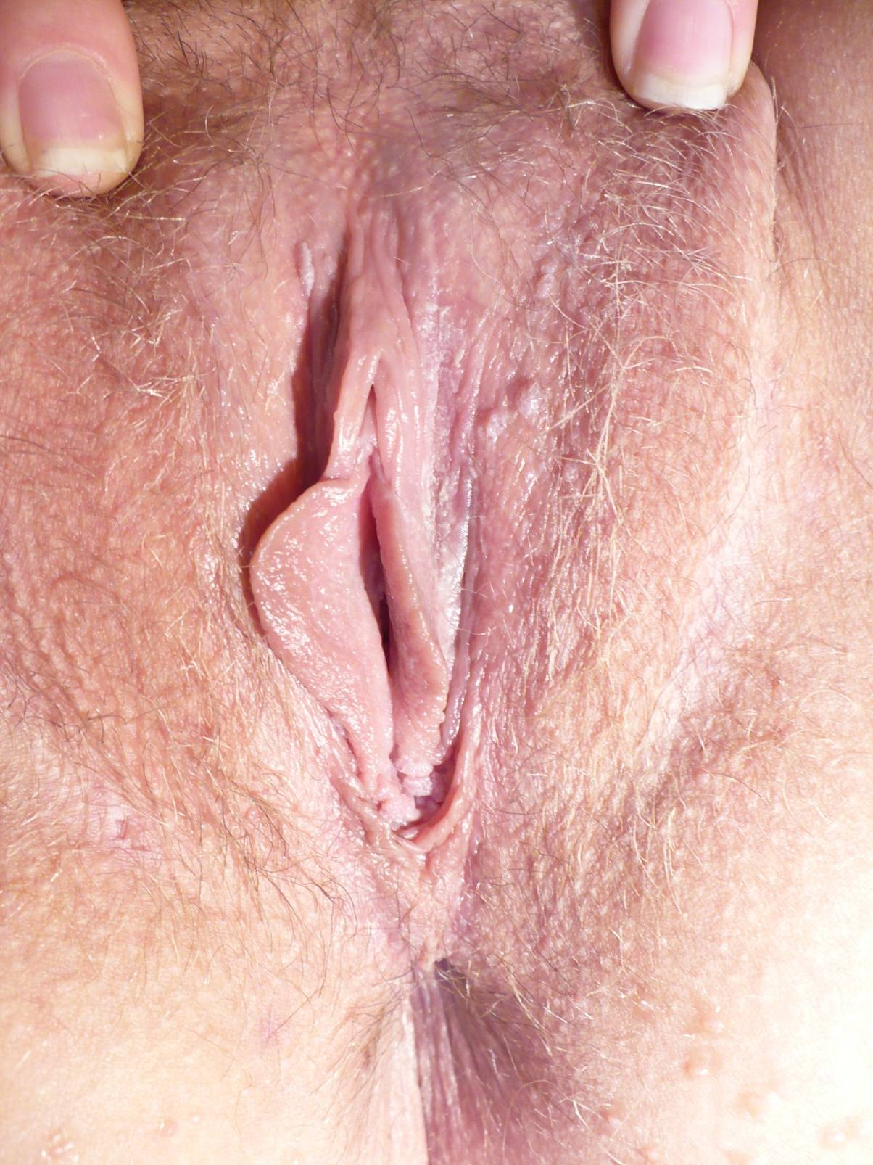
1.a. Lésions bénignes verruqueuses
Types de lésions

Slide 7
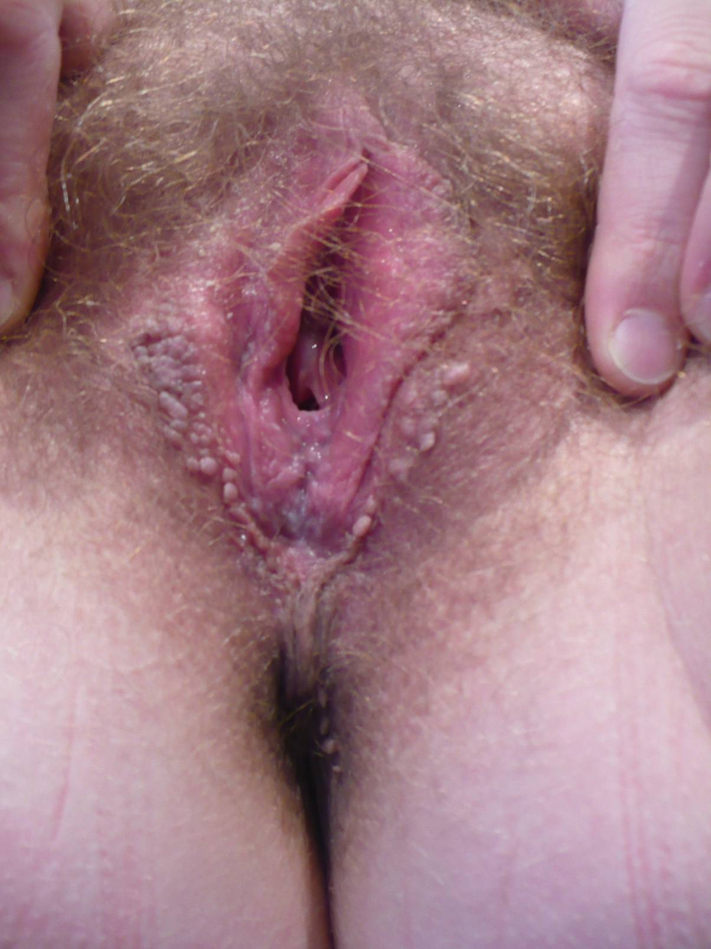
1.a. Lésions bénignes verruqueuses
Types de lésions

Slide 8
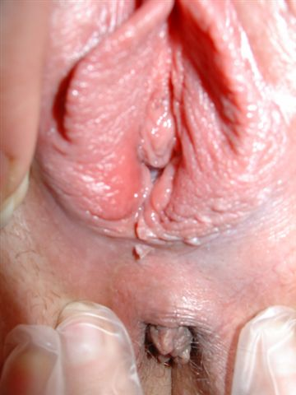
1.b. Lésions bénignes papuleuses
Types de lésions

Slide 9
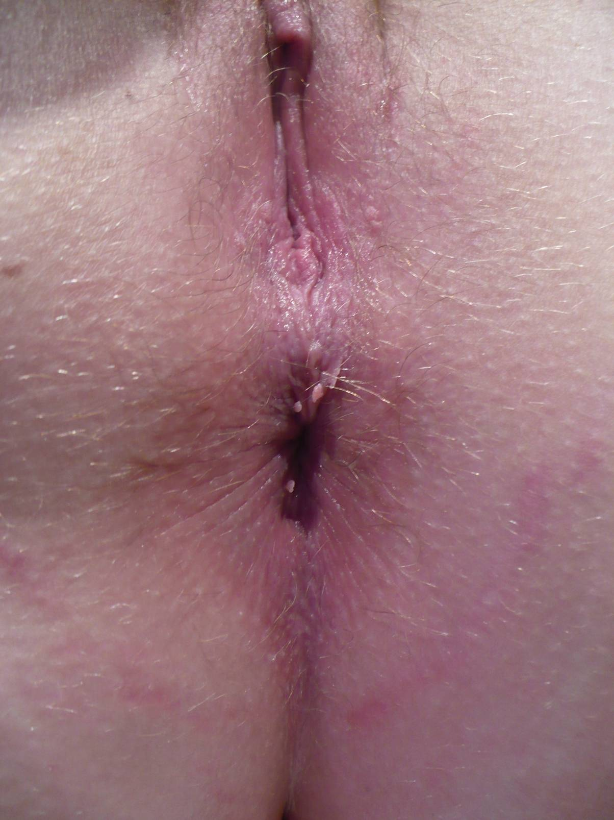
1.b. Lésions bénignes papuleuses
Types de lésions

Slide 10
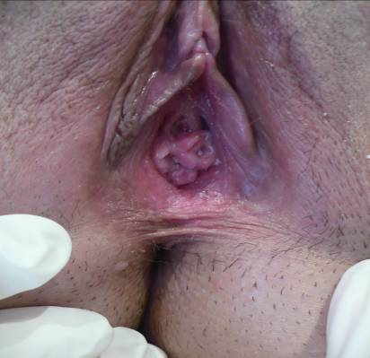
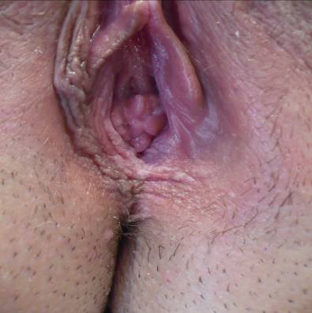
1.c. Lésions bénignes planes
Types de lésions
Invisibles sans acide acétique

Slide 11
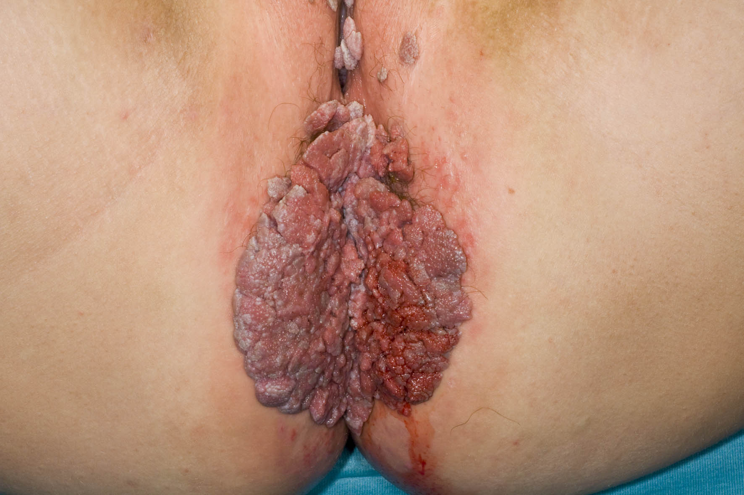
Buschke Löwenstein HPV 6/11
Types de lésions

Slide 12
Mise au point
Recherche d’une surinfection/coinfection
Biopsie ?
Recherche d’atteintes des autres muqueuses
Sérologie MST
Contrôle du partenaire
Abus ?
Diagnostic différentiel : Molluscum Contagiosum

Slide 13
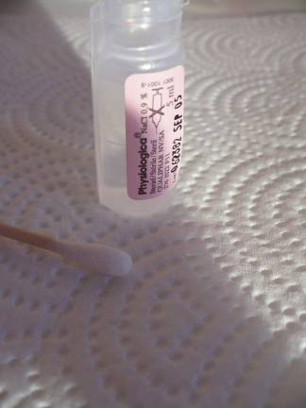
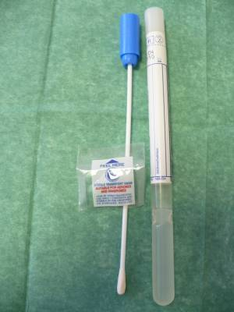
1.Recherche d’une surinfection
    Frottis :Candida, Gardnerella

Slide 14
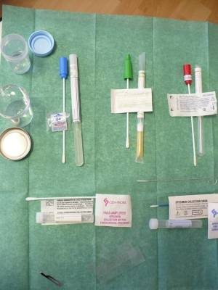
1. Recherche d’une coinfection
Frottis autres MST :
  Normal : Gonocoque
  Trichomonas
  Chlamydia
  Mycoplasme
  Viral (herpes et HPV)

Slide 15
2. Biopsie ? Quand ?
S’il y a des lésions d’évolution chronique ou résistantes au traitement
Si lésions pigmentées ou étendues
Si lésions ulcérées ou hyperkératosiques
Chez les immunodéprimés
En cas de doute diagnostique

Slide 16
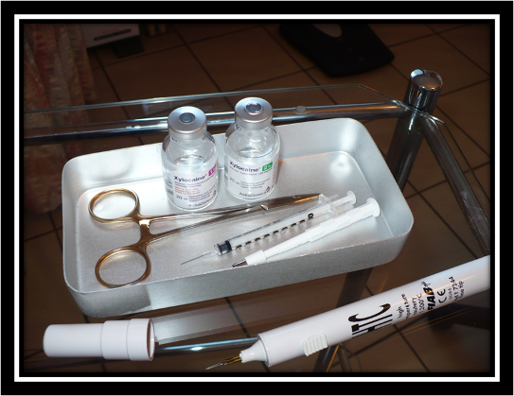
2. Biopsie ?
Histologie
Immunofluorescence
Notes:
16

Slide 17
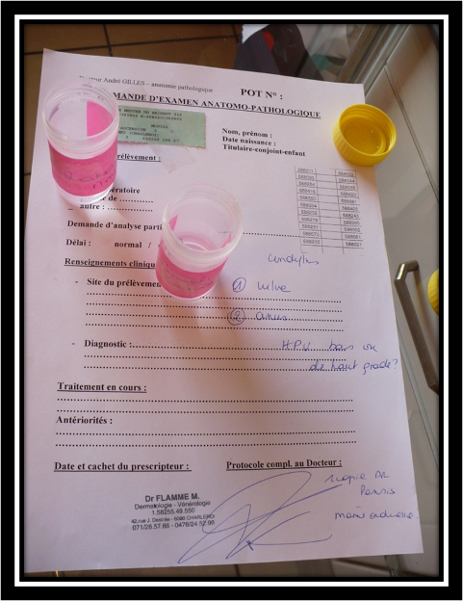
2. Biopsie ?
Notes:
17

Slide 18


Slide 19

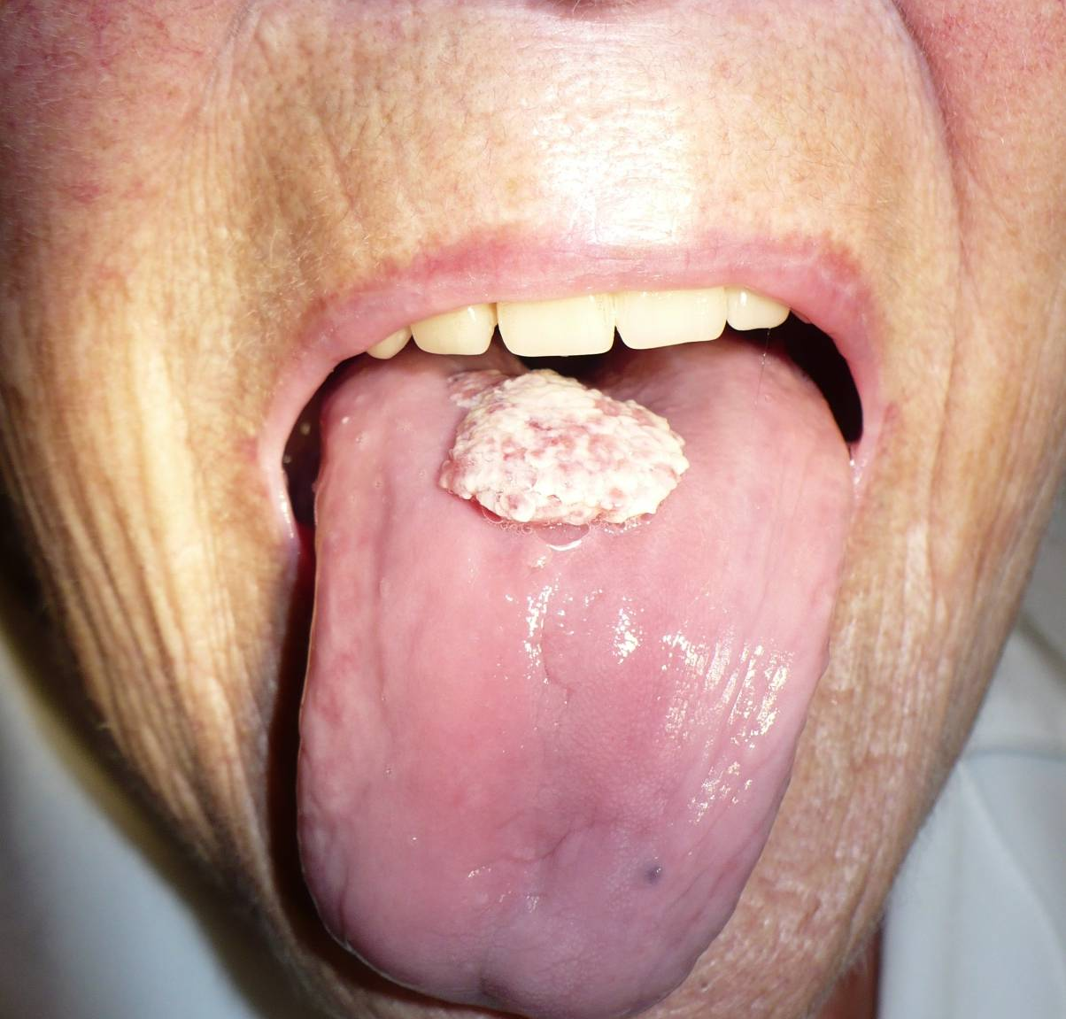
3. Recherche d’atteintes des autres muqueuses

Slide 20
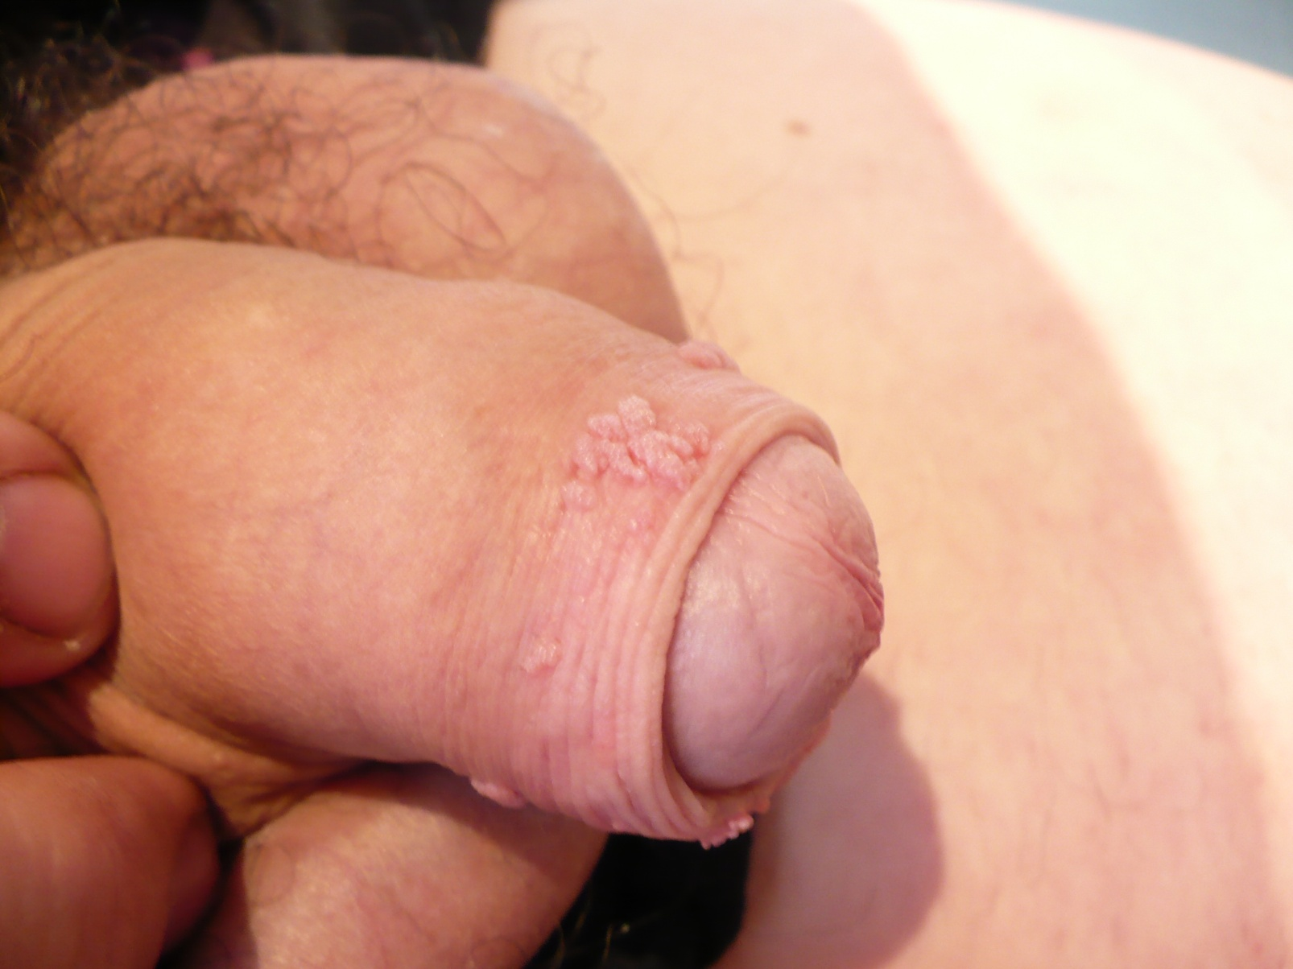
5. Contrôle du partenaire

Slide 21
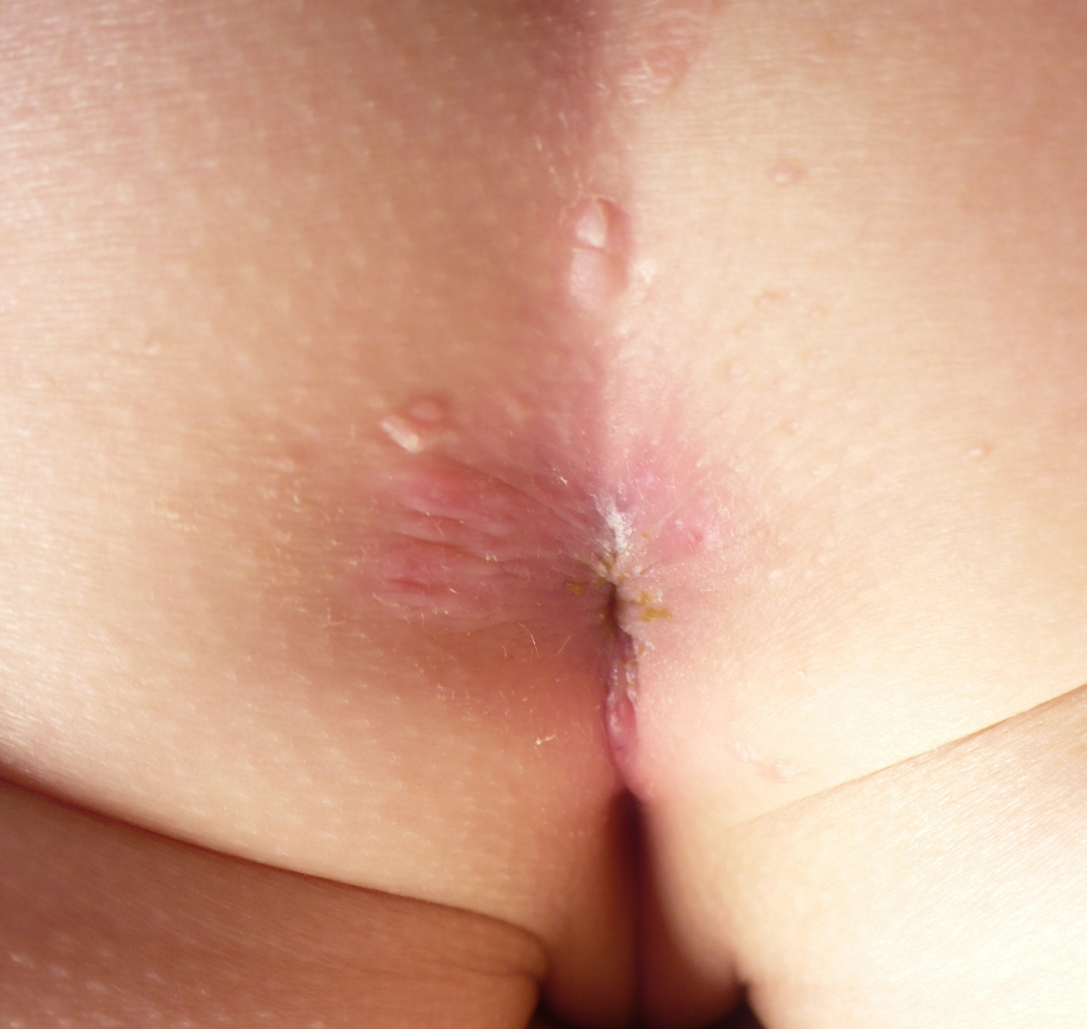

Slide 22
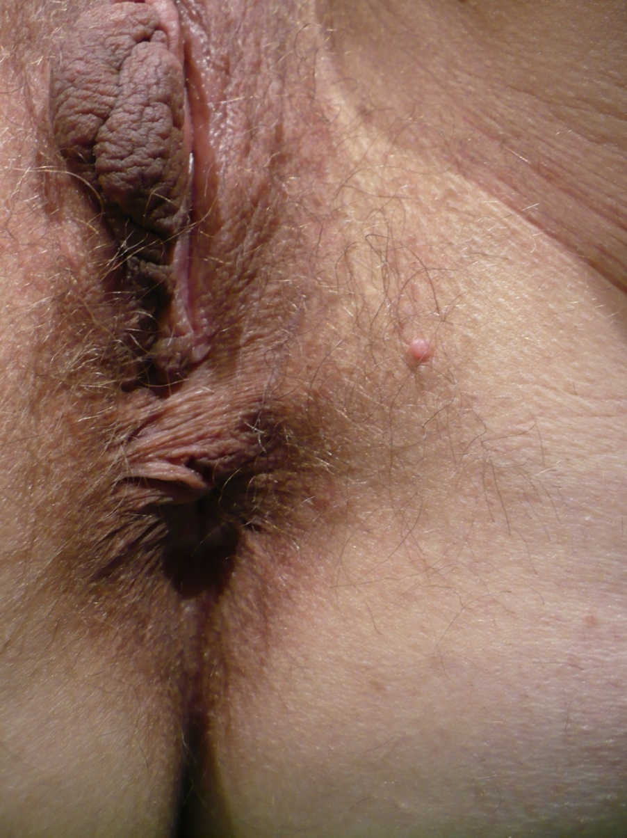
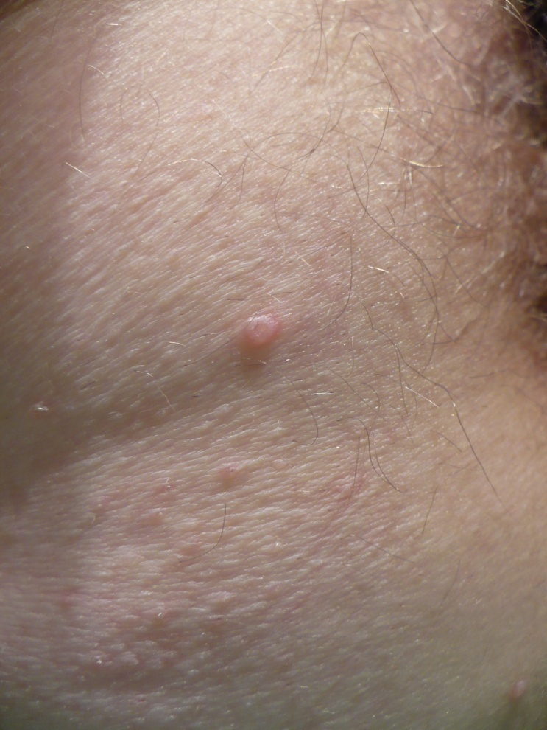
7. Diagnostic différentiel : Molluscum contagiosum

Slide 23
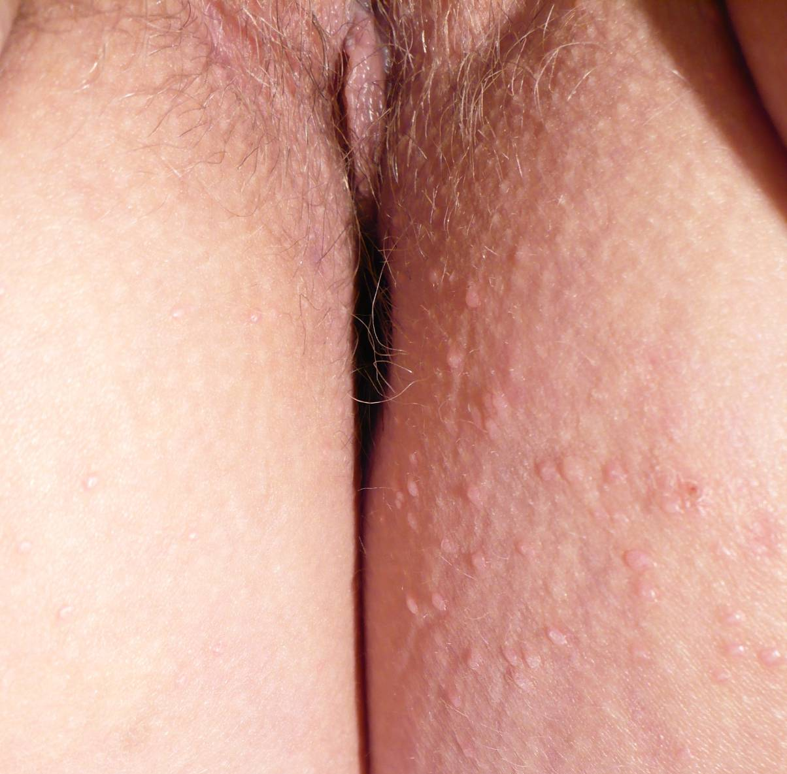
7. Diagnostic différentiel : Molluscum contagiosum

Slide 24
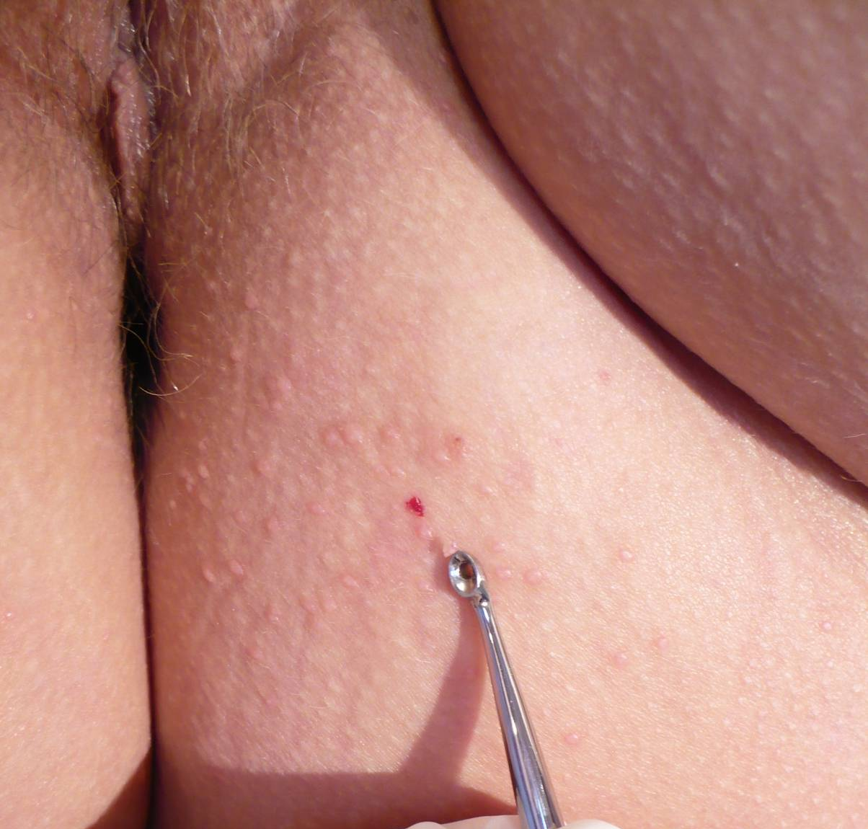
7. Diagnostic différentiel: Molluscum contagiosum

Slide 25


Slide 26
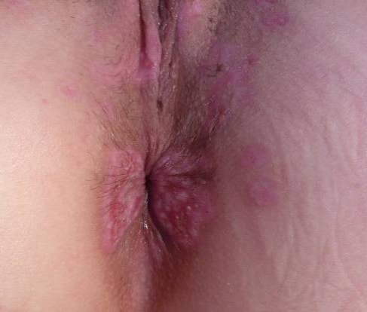
Prise en charge/traitement Cryothérapie
Recidive de condylomes post-laser

Slide 27
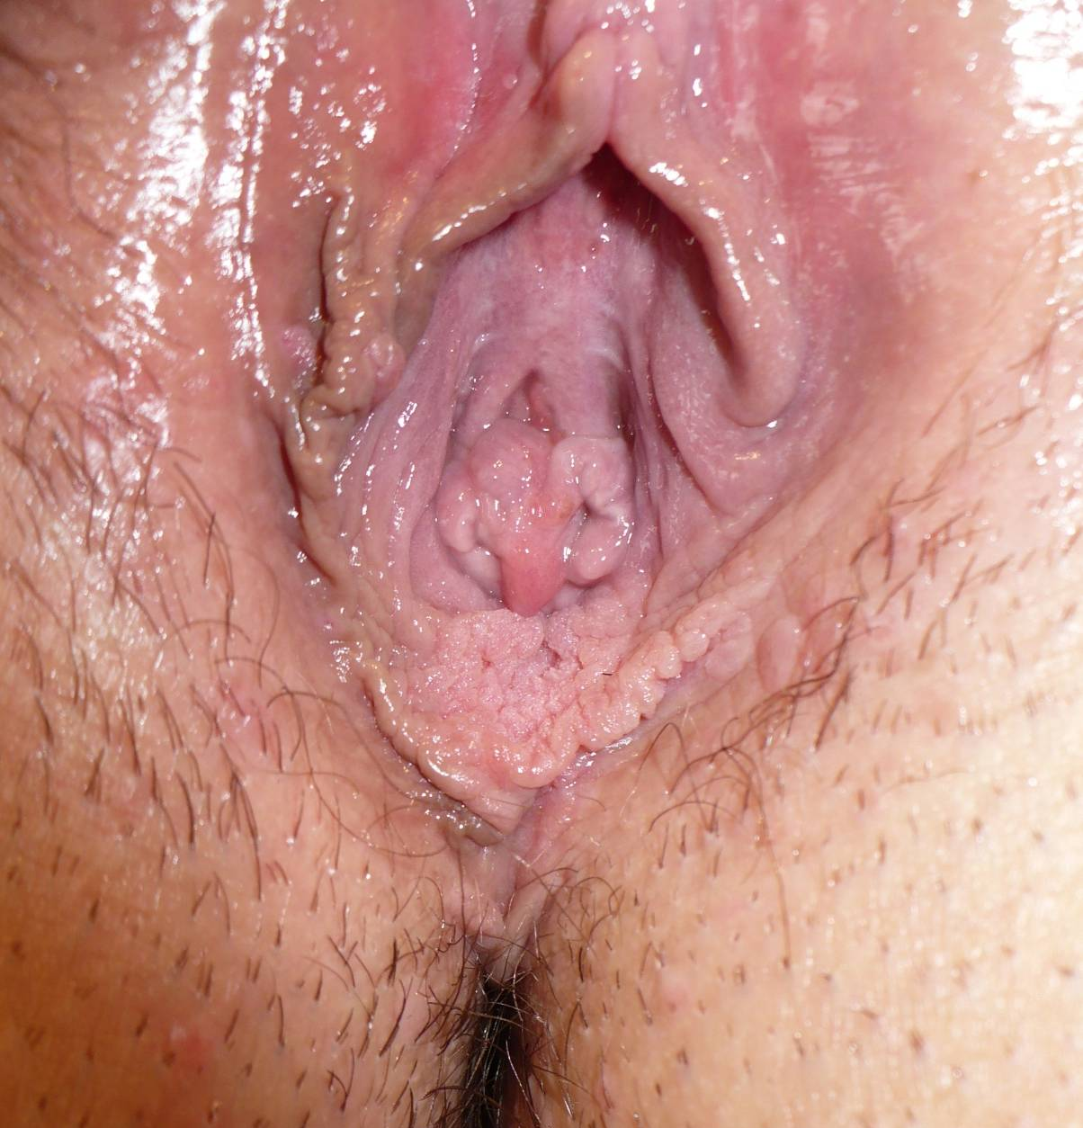
Prise en charge/traitement ALDARA
11/07

Slide 28
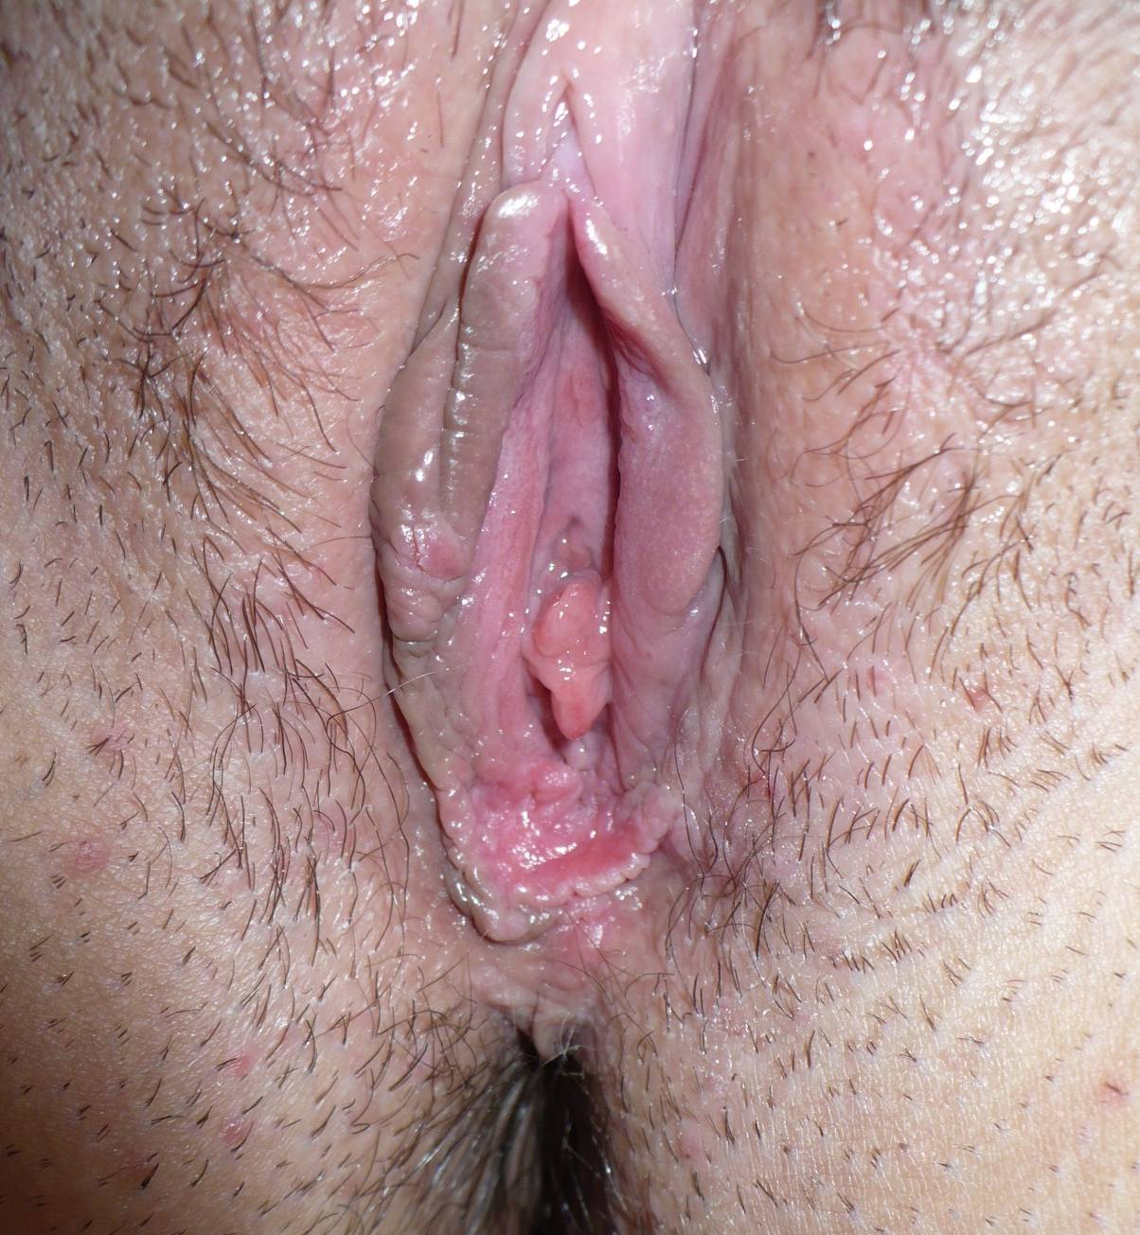
Prise en charge/traitement ALDARA
14/07

Slide 29

D. Prise en charge/traitement ALDARA
01/08

Slide 30

D. Prise en charge/traitement ALDARA
01/08 + acide acétique

Slide 31
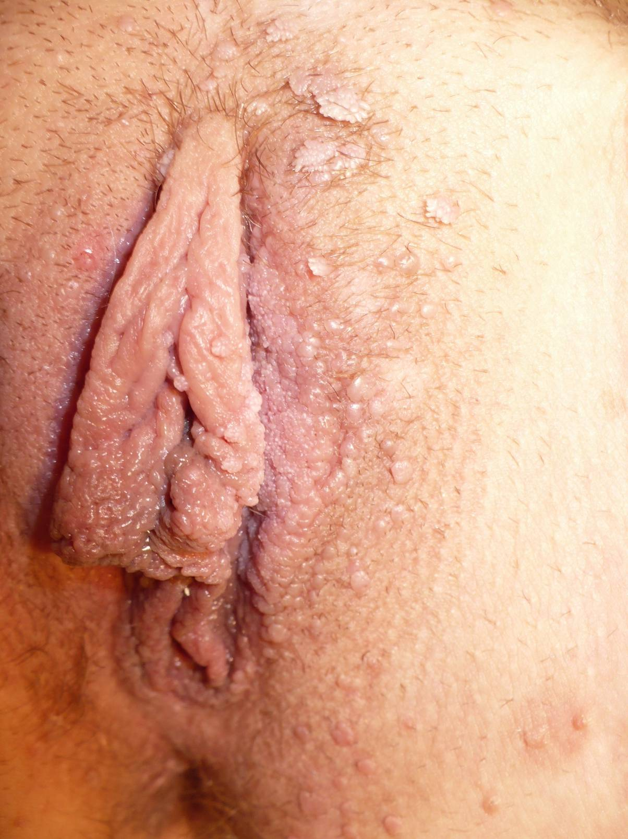
Prise en charge/traitement Cryothérapie
12/07

Slide 32
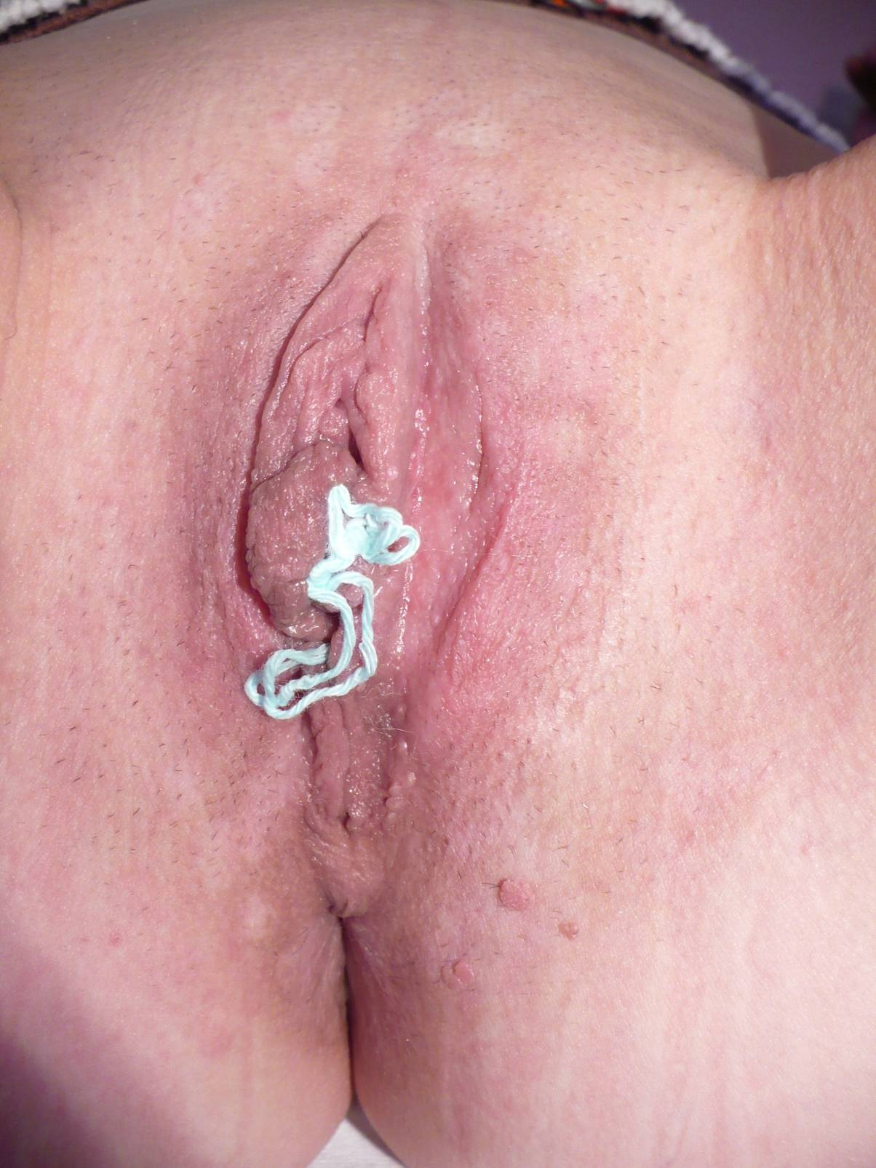
D. Prise en charge/traitement Cryothérapie + Aldara

Slide 33
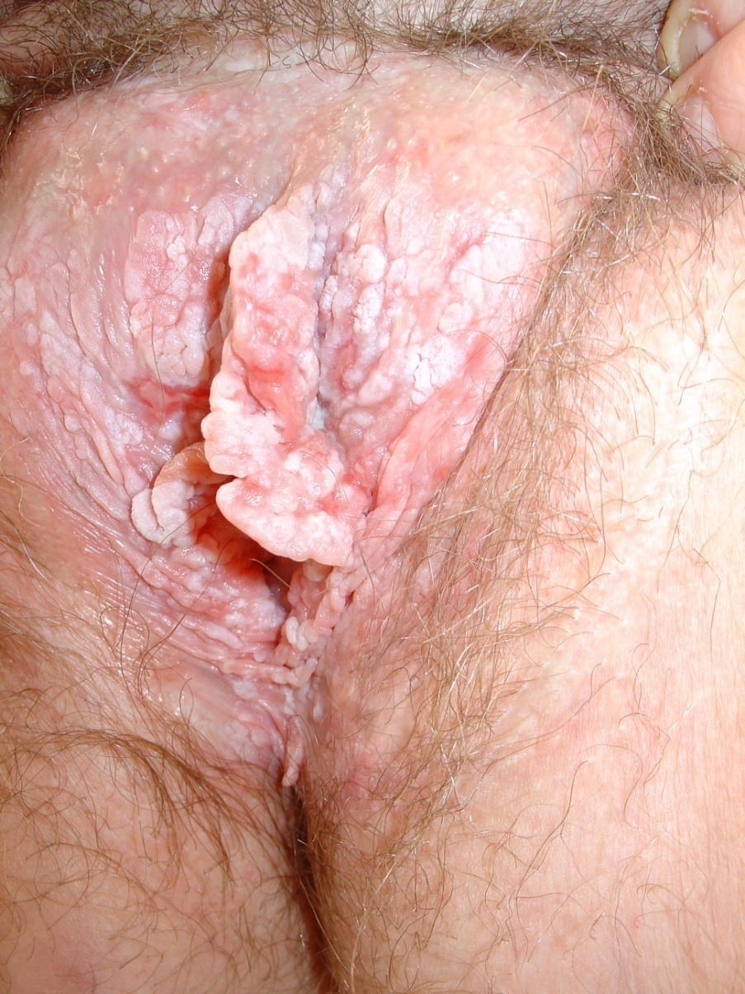
2. Lésions précancéreuses : VIN

Slide 34
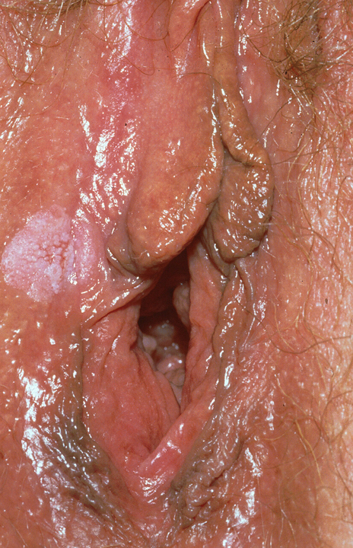
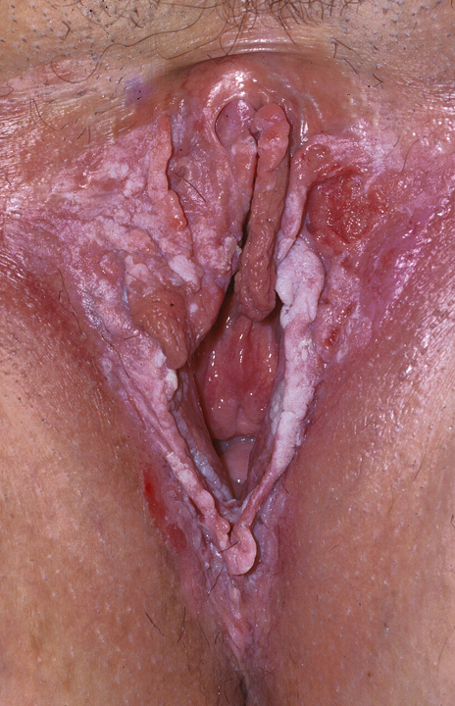

Slide 35
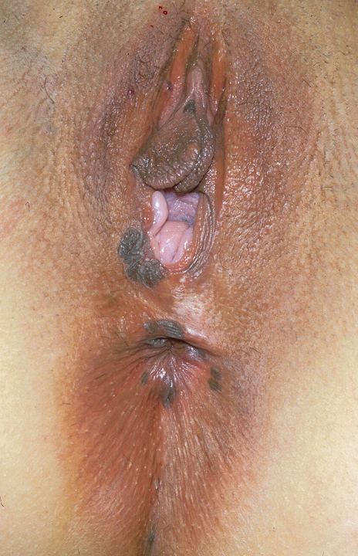
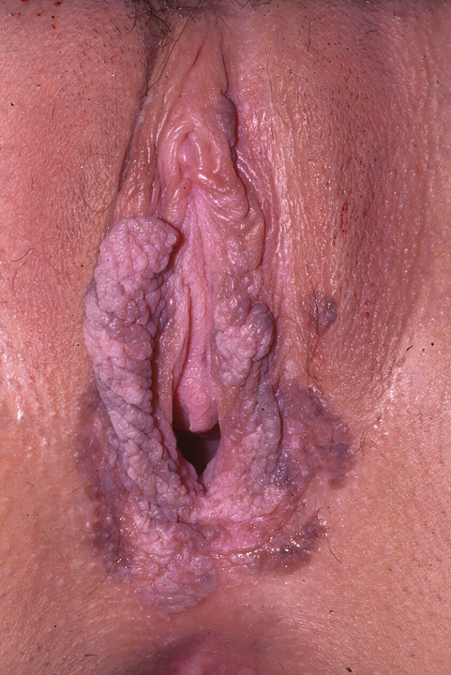

Slide 36
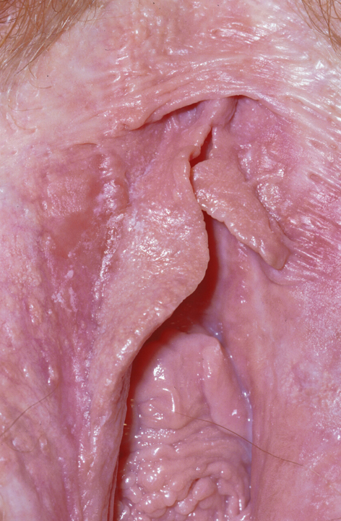
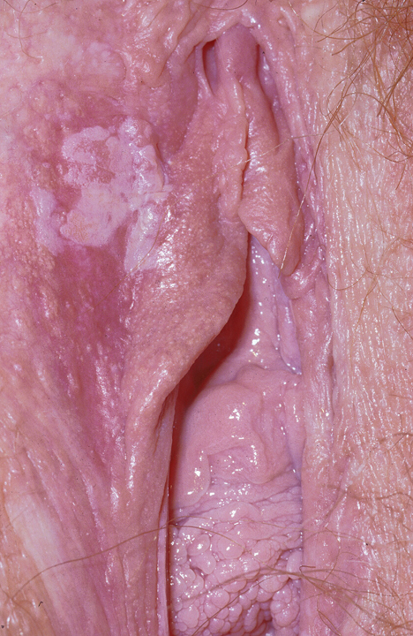

Slide 37
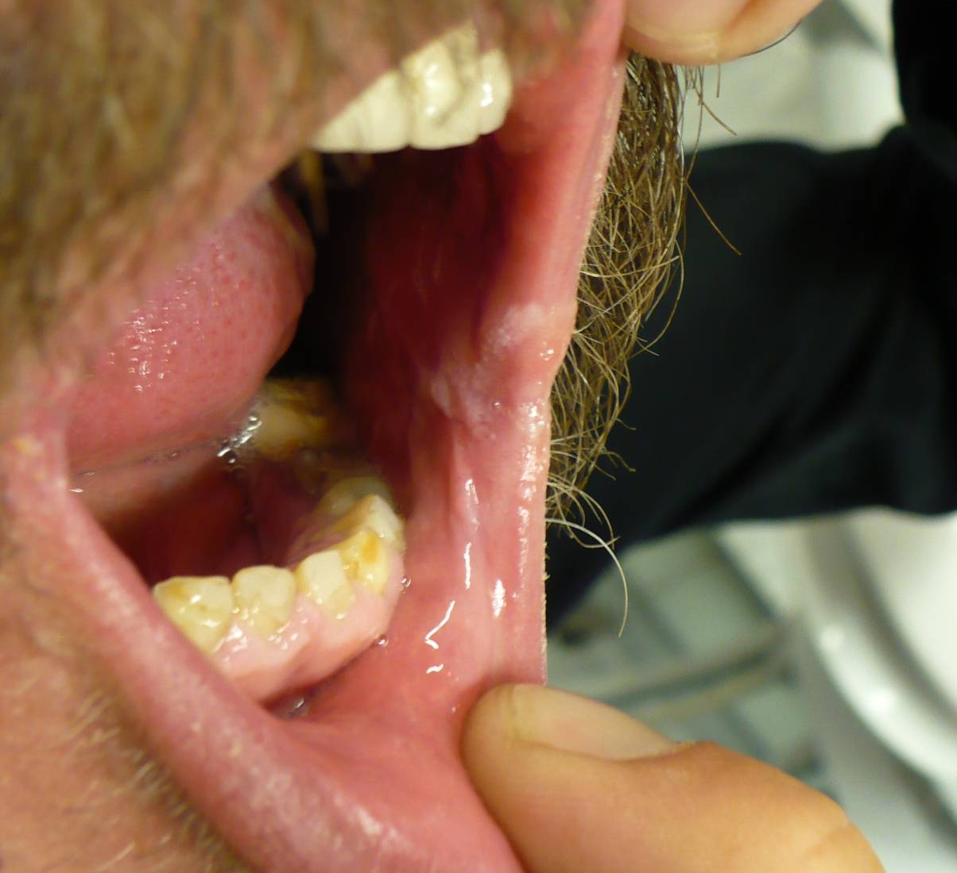
Recherche d’atteintes des autres muqueuses
Leucoplasie HPV +

Slide 38
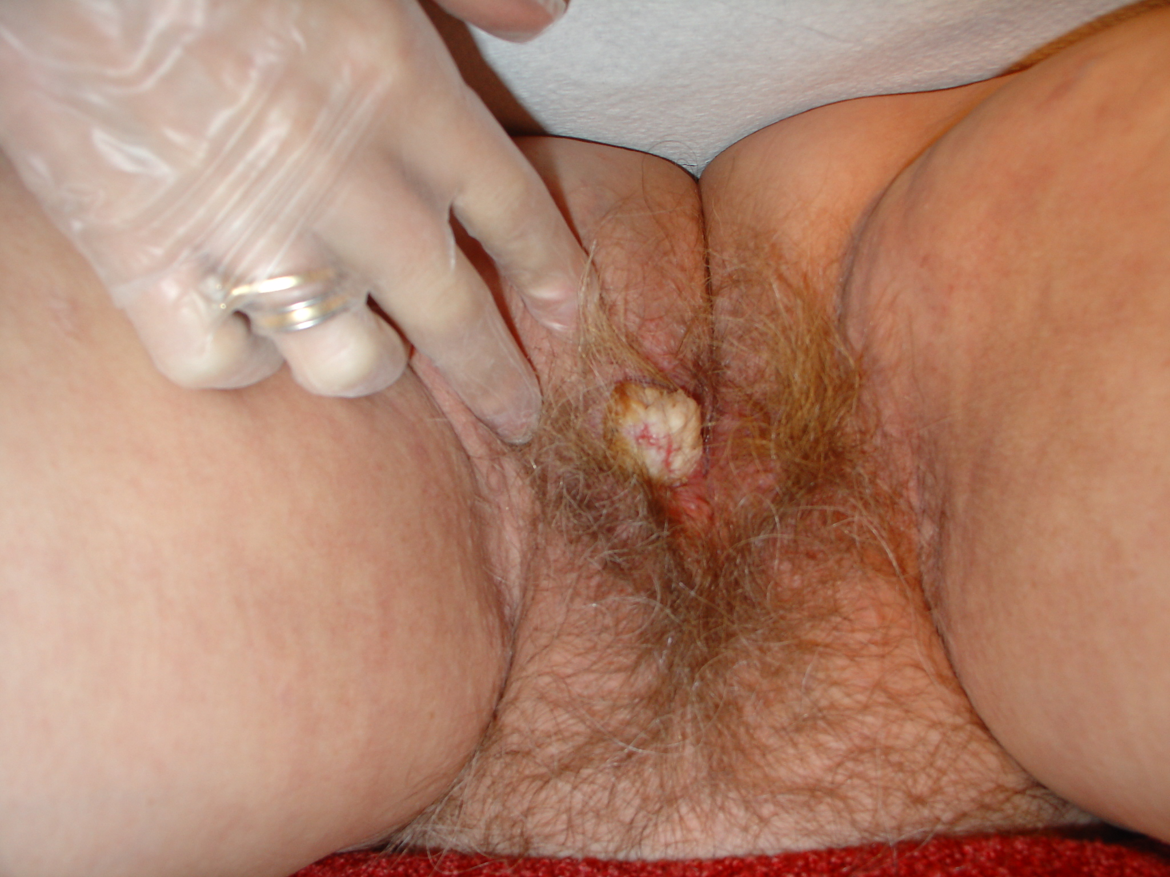
3. Lésions cancéreuses : carcinomes spinocellulaires

Slide 39
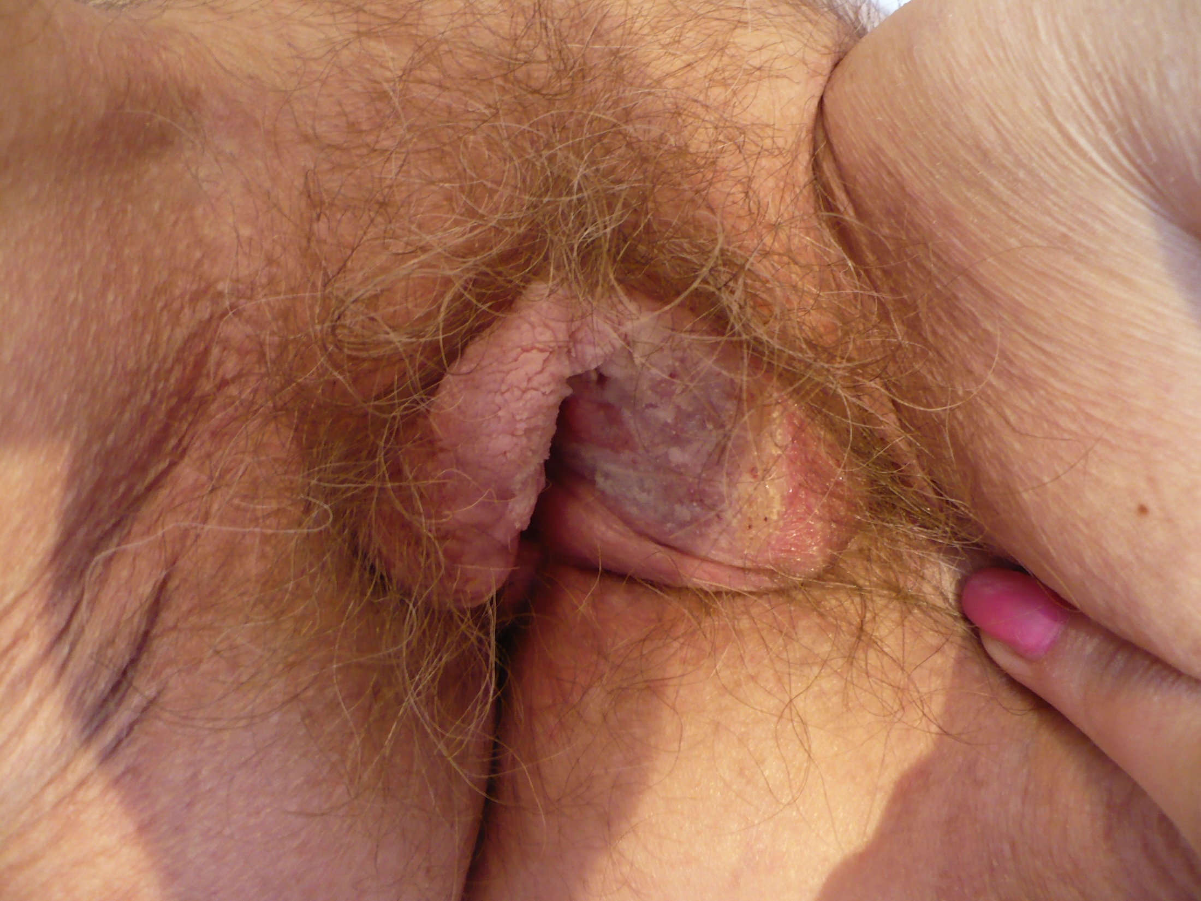

Slide 40
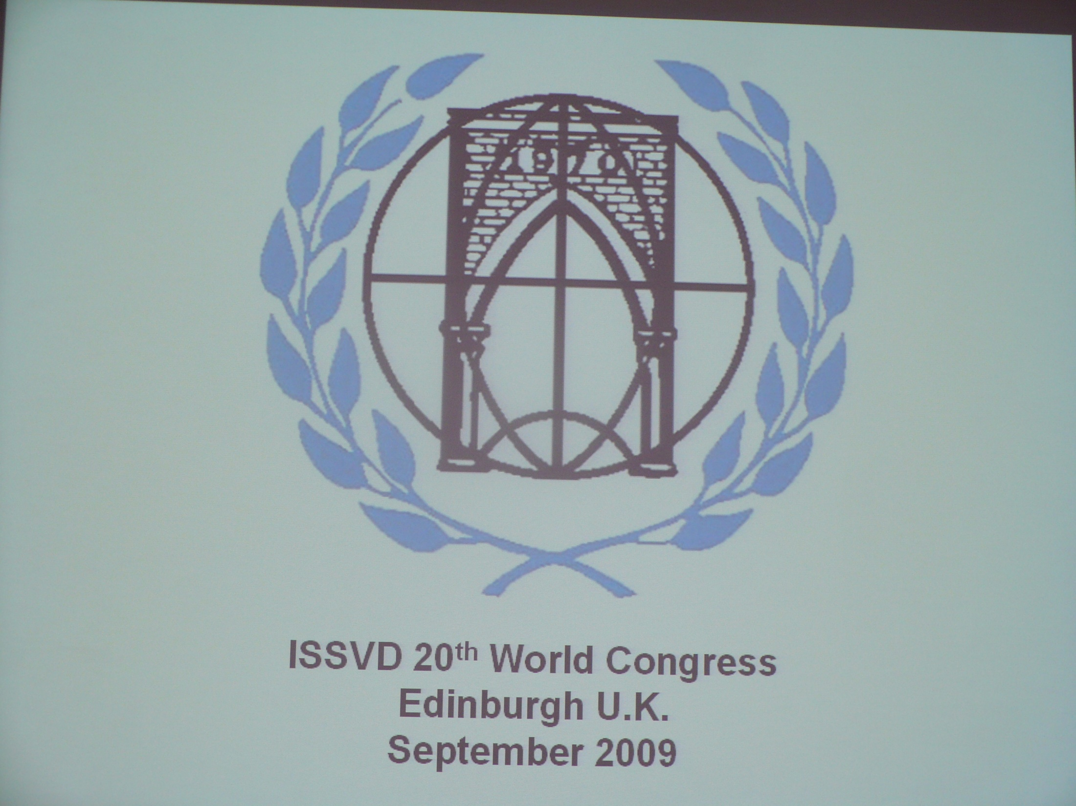

Slide 41


Slide 42


Slide 43
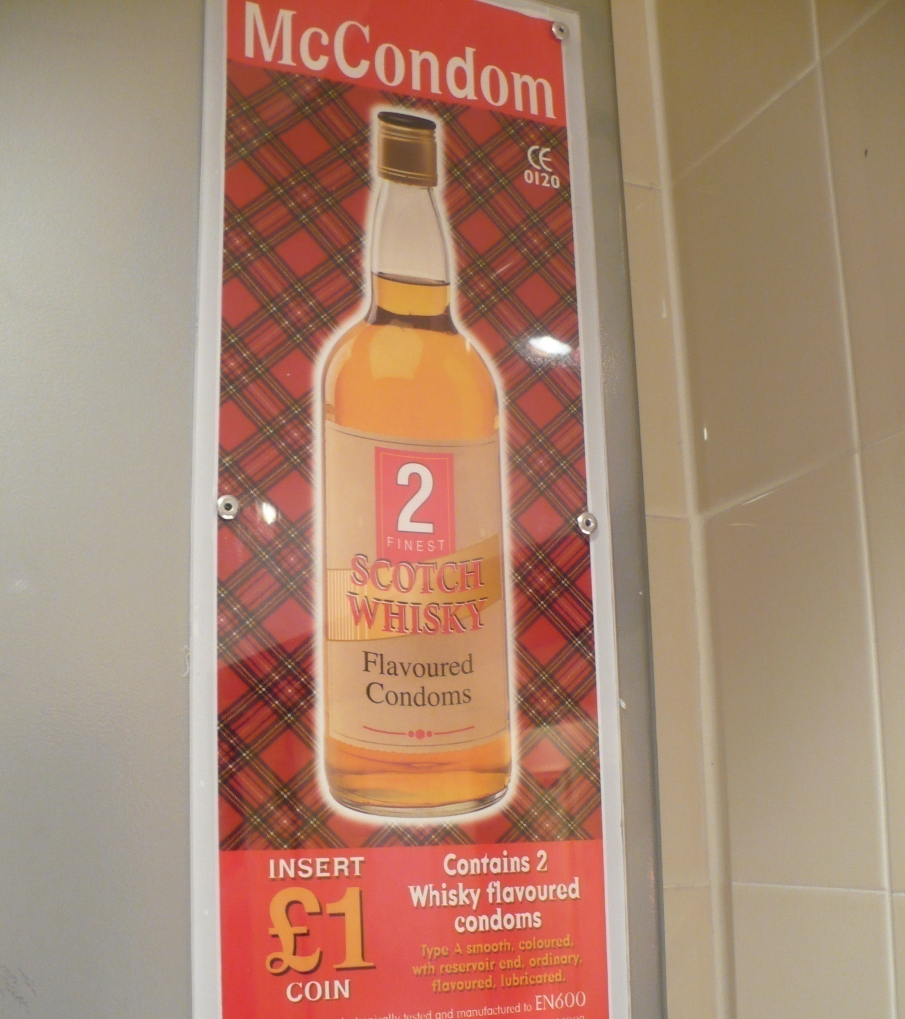

Slide 44

HPV and vaccination
Suzanne M. Garland
Director of Microbiological Research,
Director of Clinical Microbiology and Infectious Diseases,
The Royal Women's Hospital,
Professor, Department of Obstetrics, Gynaecology, University of Melbourne
Melbourne, Australia.
Inaugural and Past President of AOGIN
ISSVD, Edinburgh, September 11th 2009
Notes:
HPV and vaccination

Slide 45
Estimated world burden of HPV-related disease and diagnoses
Cervical cancer: 0.493 million in 2002¹
High-grade precancerous lesions:
10 million²
Low-grade cervical lesions:
30 million²
Genital warts: 30 million³
Attributable to oncogenic HPV types
HPV infection
without detectable abnormalities:
300 million²
Attributable to nononcogenic HPV types
Adjusted global prevalence of HPV 10.41%
1. Parkin DM, Bray F, Ferlay J, Pisani P. CA Cancer J Clin. 2005;55:74–108. 2. World Health Organization. Geneva, Switzerland: World Health Organization; 1999:1–22. 3. World Health Organization. WHO Office of Information. WHO Features. 1990;152:1–6.
Notes:
Key Points
HPV infection is very common, but, in the majority of cases, has no clinical significance. Of all HPV-related conditions, cervical cancer is the most serious manifestation of the virus. However, most HPV-related morbidity is associated with cervical dysplasia or genital warts.
Cervical dysplasia is caused by both oncogenic and non-oncogenic types, and genital warts by non-oncogenic types.
Background
According to estimates from the World Health Organization, worldwide annual incidence of HPV infection and low- and high-grade dysplasia is 300 million, 30 million, and 10 million cases, respectively.¹ The World Health Organization estimates that 30 million cases of genital warts occur every year.²
The largest number of cases of cervical HPV infection have no detectable cytologic abnormalities, and many of these are self-limited. However, an important subset will subsequently become associated with disease.¹
HPV infection with oncogenic types, notably Types 16 and 18, is associated with both low-grade and high-grade cervical lesions. HPV infection with these types can lead to cervical cancer.³
Nononcogenic HPV types, notably Types 6 and 11, are associated with low-grade cervical lesions and with anogenital warts.^{3,4} In a study by Gissmann and colleagues (N=63), HPV 6 and 11 DNA was detected in >90% of anogenital warts.⁵
References
1. World Health Organization. The current status of development of prophylactic vaccines against human papillomavirus infection. Report of a technical meeting, 16–18 February 1999. Geneva, Switzerland: World Health Organization; 1999:1–22.
2. World Health Organization. Sexually transmitted infections increasing–250 million new infections annually. WHO Office of Information. WHO Features. 1990;152:1–6.
3. Burd EM. Human papillomavirus and cervical cancer. Clin Microbiol Rev. 2003;16:1–17.
4. Wiley DJ, Douglas J, Beutner K, et al. External genital warts: diagnosis, treatment, and prevention. Clin Infect Dis. 2002;35(suppl 2):S210–S224.
5. Gissmann L, Wolnik L, Ikenberg H, Koldovsky U, Schnurch HG, zur Hausen H. Human papillomavirus types 6 and 11 DNA sequences in genital and laryngeal papillomas and in some cervical cancers. Proc Natl Acad Sci USA. 1983;80:560–563.

Slide 46
Comparison of main parameters for trials of the bivalent and quadrivalent HPV vaccines
Parameter | Bivalent vaccine | Quadrivalent vaccine
Sample Size (all females) | 18,644 | 20,541
Key Inclusion Criteria
(years) | 15 to 25 | 16 to 26
Lifetime Sex Partners | 0 to 6 | 0 to 4
Key Exclusion Criteria
Visible Genital Warts | NO | YES
HSIL Pap Cytology on Day 1 | YES | NO
Comparator | Hepatitis A Vaccine | Placebo (Adjuvant)
Visit Schedule
Screening Cytology | 12 month intervals | 6 to 12 month intervals
Cervicovaginal Sampling | 6 month intervals | 6 to 12 month intervals
Primary Endpoint | HPV 16/18-related CIN 2/3 or AIS | HPV 16/18-related CIN 2/3 or AIS
Brown D and Garland SM Cervical Cancer Vaccines: Principles and Practice of Oncology 2008: 22:4:1-12
Notes:
PPE (Per-protocol susceptible population)
Naïve to the relevant HPV types at Day 1 (PCR and serology)
No exclusion based on Day 1 Pap test result
Received all 3 doses
Remained free of infection with the relevant HPV type through 1 month Postdose 3 (PCR)
No protocol violation
Case counting starting 1 month Postdose 3
Approximates adolescent and young adult females who receive a full course of GARDASIL prior to exposure to vaccine types
Relevance – 11-12 year-old sexually naïve females

Slide 47
Outcomes to date: per protocol efficacy populations
Phase III Randomised Control Trials (RCTs)
vaccine Gardasil® Cervarix®
follow up 4 years 38 months
prophylactic efficacy
HPV 16 CIN 2/3+/AIS established established
HPV 18 CIN2/3+/AIS established established
98% (100%) 93% (98%)
HPV 16/18 VIN 3 established not reported
HPV 16/18 VaIN 3 established not reported
100%
6/11 anogenital disease
EGW, VIN1 VaIN1 established not a target
99%, 100%
tolerability well tolerated well tolerated
therapeutic efficacy none none

Slide 48
Immunogenicity
-- different assays
-- no level antibody yet that is an immune correlate of protection
Notes:
Choice not seen in vaccines
the immune correlate of protection?
Durability Ig :long-term protection critical utility public health intervention
- 5-8 years
- immune memory
- ? anamnestic response natural mucosal?

Slide 49


Slide 50
Viral infections of the vulva
Marc Steben, MD
Unité ITSS
Direction des risques biologiques,
environnementaux et occupationnels
Institut national de santé publique du Québec

Slide 51
Histoire naturelle de l’infection par HPV
Inoculation
Sustained
clinical
remission
First lesion
Immune
response
About
9 mo.
Active growth
(3-6 mo.)
Host
containment
(3-6 mo.)
Incubation
(1-8 mo.)
Late
stage
Persistent
or recurrent
disease

Slide 52
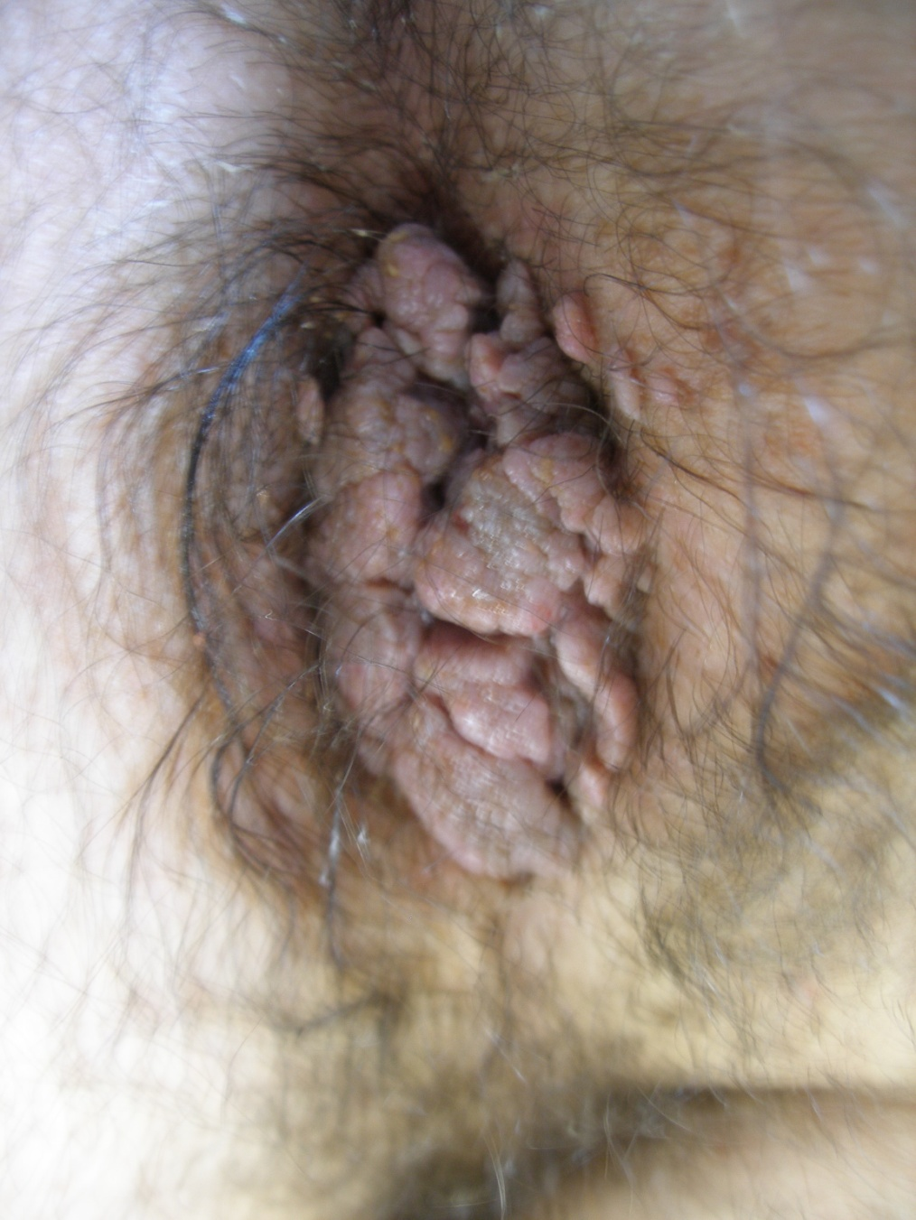
Contrôle HIV+?
Arrêt du tabac
Traitez localement par imiquimod avant toute chirurgie
Vacciner le nouveau partenaire F ou H

Slide 53


Slide 54


Slide 55

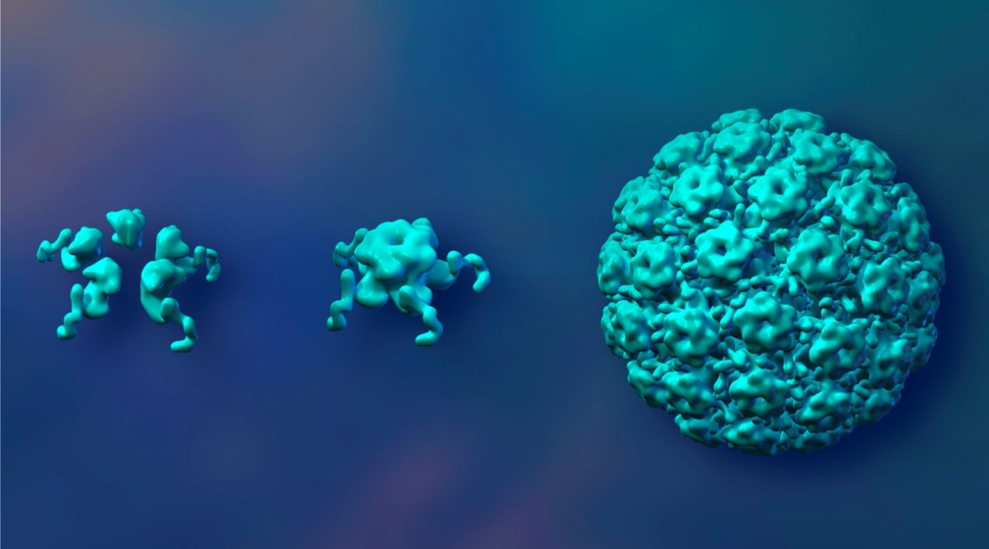
HPV- vaccine and vulvar disease
Elmar A. Joura
Universitätsklinik für Frauenheilkunde Wien
Edinburgh, 12. 9. 2009
ISSVD Postgraduate Course

Slide 56
Prevalence of genital warts in women by age in USA¹
7
6
5
4
Cases per 1,000
3
2
1
0
<10
10–14
15–19
20–24
25–29
30–34
35–39
40–44
45–49
50+
Overall: 1.7 cases per 1,000 person-years.
In 20–24 years 6.2 / 1,000
^{1.} Insinga RP, Dasbach EJ, Myers ER. Clin Infect Dis. 2003;36:1397–1403.
*n=5095/366486 cases in 2000 billed through the health plan
Notes:
56

Slide 57
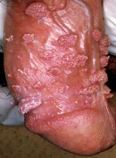
Incidence of Genital Warts
England and Wales (1971−2006)
Health Protection Report:, Volume 1 Number 35, Published 31 August 2007
Notes:
Key Point
The incidence of diagnoses of condyloma in England and Wales have increased dramatically over the past 30 years.
Background
Condyloma is the most commonly diagnosed sexually transmitted viral infection in genitourinary medicine (GUM) clinics in England and Wales.¹
The figure shows the surveillance data on genital warts reported by genitourinary medicine (GUM) clinics in England and Wales to the PHLS Communicable Disease Surveillance Centre through KC60 returns.¹
In 2000, there were approximately 66,000 and 51,000 cases of condyloma in males and females, respectively, about 50% of which were first-attack cases. The incidence increased greatly from 37/100,000 to 257/100,000 for males and 19/100,000 to 195/100,000 for females, between 1971 and 2000.¹
Despite growing concerns about acquired immune deficiency syndrome (AIDS) and the adoption of safe sex practices, the incidence of genital warts is increasing. Studies have shown that the use of condoms offers limited protection against HPV infection.^{2,3}
References
1. Sexually transmitted infections quarterly report: Anogenital warts and HSV infection in England and Wales. CDR Wkly (Online). 2001;11(35). Available at: http://www.hpa.org.uk/cdr/archives/2001/cdr3501.pdf. Accessed June 10, 2005.
2. Manhart LE, Koutsky LA. Do condoms prevent genital HPV infection, external genital warts, or cervical neoplasia? A meta-analysis. Sex Transm Dis. 2002;29:725–735.
3. Winer RL, Lee S-K, Hughes JP, Adam DE, Kiviat NB, Koutsky LA. Genital human papillomavirus infection: Incidence and risk factors in a cohort of female university students. Am J Epidemiol. 2003;157:218–226.

Slide 58
Trends in Vulvar Neoplasia
SCC: bimodal age-distribution
n
Joura et al., J Reprod Med 2000

Slide 59


Slide 60


Slide 61


Slide 62
Vulval Intraepethelial Neoplasia
R.W. Jones
National Women’s Hospital
Auckland
New Zealand

Slide 63
VIN Terminology
Squamous
1986 2004
VIN 1
VIN 2 VIN “usual” type
VIN 3 (warty, basaloid, mixed)
Differentiated VIN VIN “differentiated” type
(& VIN “unclassified”)
Non-squamous Paget’s disease of the
vulva
Melanoma in-situ
Sideri et al. J Reprod Med 2005; 50: 807-14.

Slide 64
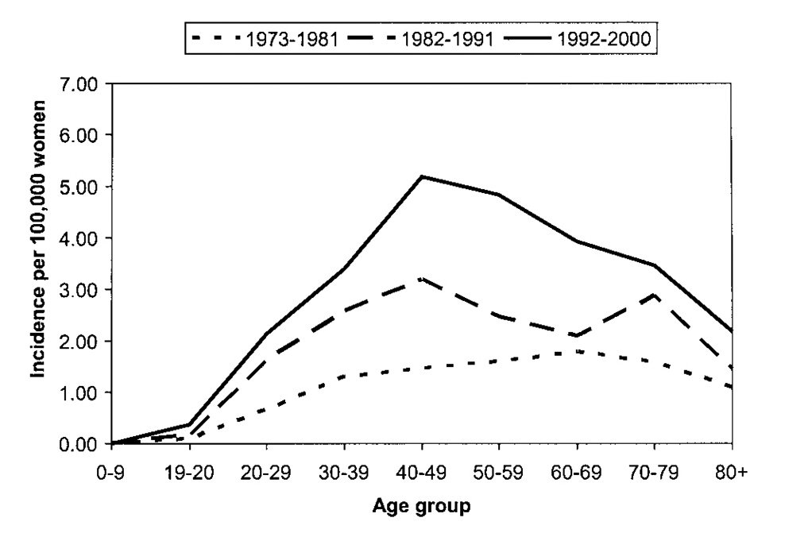
Incidence of in situ vulvar carcinoma by age and
diagnosis year. The incidence of in situ vulvar
carcinoma increased by 411% from 1973 to 2000.
Judson. Incidence of Vulvar Carcinoma. Obstet Gynecol 2006.

Slide 65
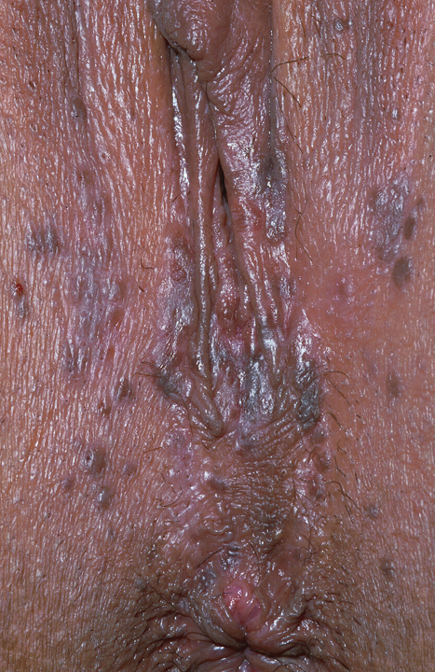
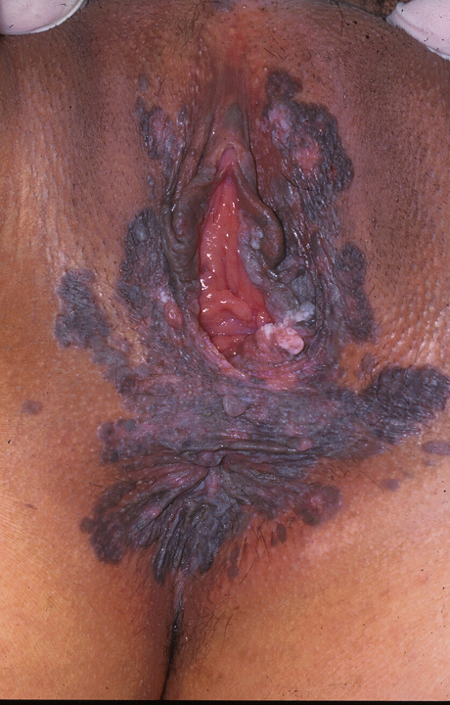

Slide 66
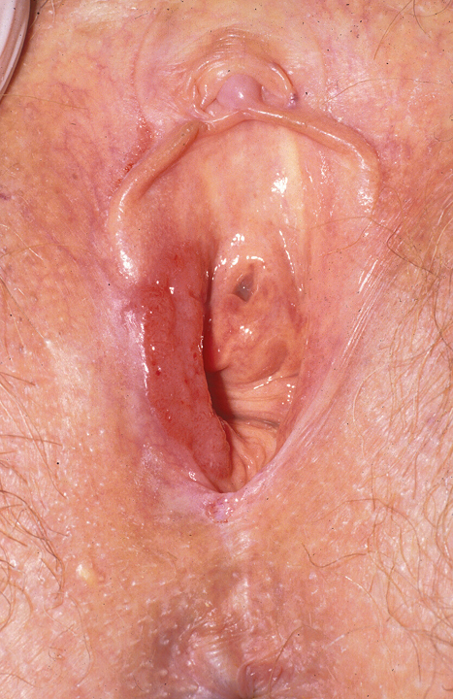
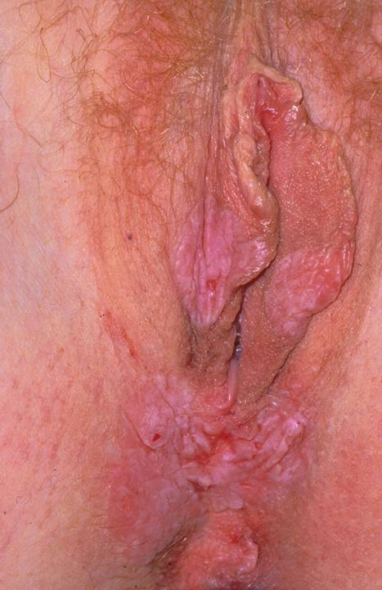

Slide 67
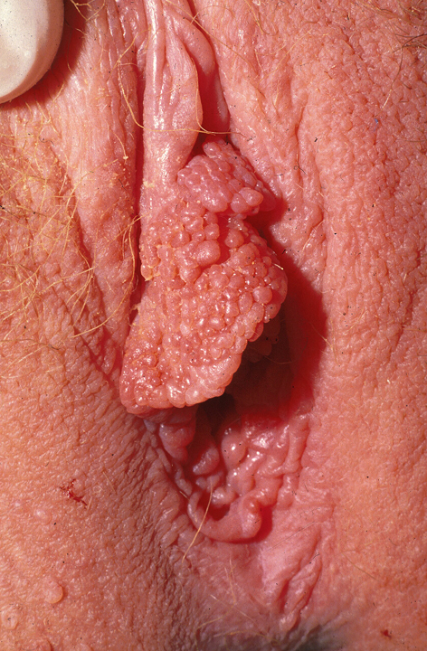
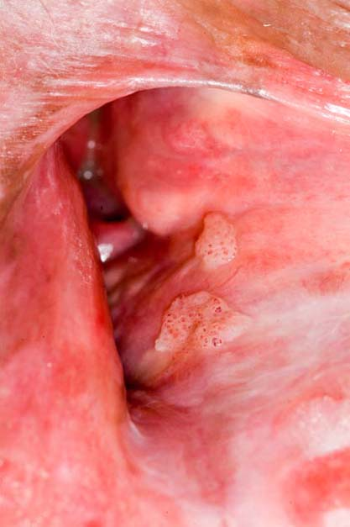

Slide 68
VIN
Medical Therapy
5 FU Largely abandoned
Imiquimod

Slide 69
Comparison of CIN 3 and VIN 3
 | CIN 3 | VIN 3
Presentation | Abnormal Pap Smear | Symptoms or clinical findings
Field | Transformation Zone | Entire vulva and perianal skin
Symptoms | - | 80% of cases
Visible Lesion | - | +
Annual Progression rate to invasion | 1-2% | 10% +
‘Lifetime’ risk of cancer following treatment | 0.3% | 4 - 5%

Slide 70


