Slide 1

XIIèmes Journées Liégeoises de Gynécologie Obstétrique
Place des SPRMs en contraception
A Pintiaux, JM Foidart, NChabbert-Buffet, P Bouchard
et le groupe d’étude du VA 2914
APHP/UPMC- ULg
Paris-Liège

Slide 2
Definition
Selective progesterone receptor modulators (SPRM) represent a new class of synthetic steroids which can interact with the progesterone receptor (PR) and can exert agonist, antagonist or mixed effects on various progesterone target tissues in vivo

Slide 3
Selective Action
At the tissue level
At the cellular level
At the gene level

Slide 4
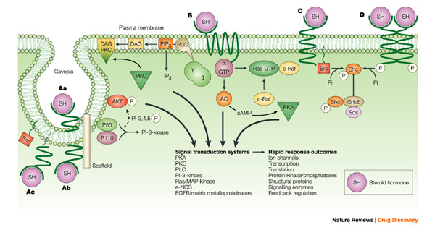
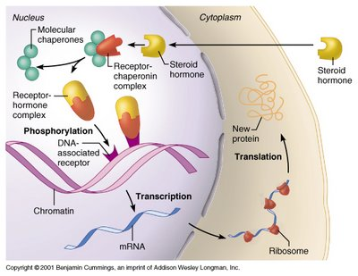
Mechanisms of Action

Slide 5
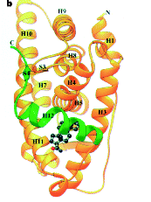
PR binding an agonist

Slide 6


PR Ligands : Mechanism of Action
Agonist/antagonist
COACTIVATORS
COACTIVATORS
Agonist
PR
PR
Pol II
Transcription activation
PRE
Stop transcription
Antagonist
COREPRESSORS
COREPRESSORS

Slide 7
First Compounds from this new class of steroids
Mifepristone (RU 486)
Onapristone (ZK 98 299)

Slide 8
New Compounds
Asoprisnil (J 867)
Ulipristal (VA2914)

Slide 9
Gynaecological uses of a new class of steroids : the selective progesterone receptor modulators
Axelle Pintiaux, Nathalie Chabbert-Buffet, Jean-Michel Foidart
Medical Abortion
Management of Miscarriage
Emergency Contraception
Long Term Contraception
Treatment of Uterine Leiomyomata
Treatment of Endometriosis
Breast Cancer
Gynecological Endocrinology, February 2009 ; 25(2) : 67-73

Slide 10
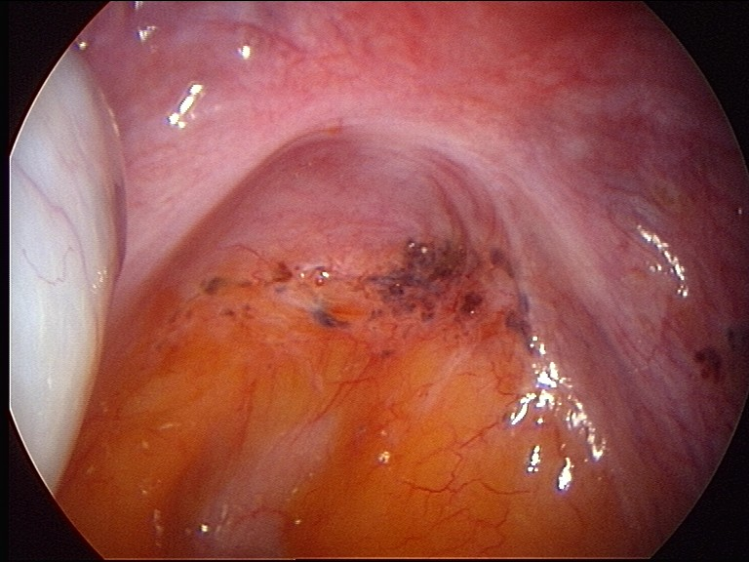
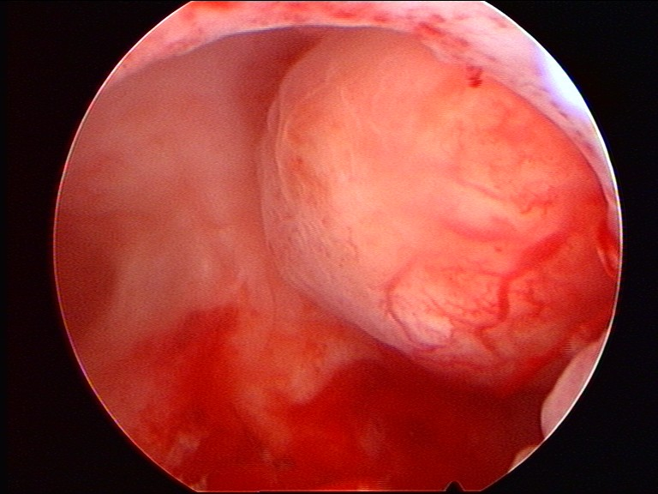
Why the need of a new class of steroids ?
To develop an estrogen-free contraception
To avoid progestin
To treat gynaecological diseases (myoma , endometriosis)
To treat or to prevent breast cancer

Slide 11
Avoid The Progestins
Breast effect
Breakthrough bleeding
Bloating
Mood changes
Acne, hirsutism
Cardiovascular effects

Slide 12
Contraceptive Mechanisms of SPRMs
Inhibition of LH peak
Inhibition of follicle rupture
Endometrial action

Slide 13
SPRMs and Emergency Pill
Mifepristone (RU 486)
Jin J, 2005 ; WHO, 1999
VA 2914
Creinin M, 2006

Slide 14
VA 2914 and Emergency Contraception
Randomised double blind trial
1672 healthy women, with regular cycles seeking emergency contraception within 72h of UI
50 mgr single dose VA 2914 + placebo 12h later versus two doses of 0.75 of LNG taken 12h apart
Primary outcome : pregnancy rate ; secondary outcome : side effects and delay in the onset of the next menses Creinin M, Obstetrics&Gynecol 2006

Slide 15
Effectiveness of Drug Based on the Interval From Exposure to Treatment
 | Total |  | 0-24 h |  | More than 24-48 h |  | More than 48-72 h
 | CDB | Levo | CDB | Levo | CDB | Levo | CBD | Levo
Exposed (n) | 775 | 774 | 273 | 263 | 268 | 298 | 234 | 213
Expected pregnancies (n)* | 47 | 42 | 19 | 14 | 14 | 16 | 14 | 12
Observed pregnancies (n) | 7 | 13 | 0 | 4 | 6 | 3 | 1 | 6
Effectiveness (%, 95% CI) | 85, 68-93 | 69, 46-82 | 100, N/E | 71, 28-89 | 57, 6-81 | 81, 42-94 | 93, 52-99 | 50, 0-77
CDB, CDB-2914 users; Levo, levonorgestrel; N/E, not estimable by method used * Calculated by using the estimated date of ovulation and the single-day pregnancy probabilitiesusing the pooled recognized pregnancies

Slide 16
VA 2914 and Emergency Contraception
Progesterone Receptor Modulator for Emergency Contraception at least as effective as LNG
VA2914 : trend of higher global effectiveness but best than LNG when intake > 48h after unprotected intercourse
VA2914 effective also after ovulation
Mild similar side effects
Adverse effect : delay of menses (increased risk of late ovulation and worry about an unintended pregnancy)
Advantage : VA2914 may be more efficacious than LNG for women who cannot obtain emergency contraception within 48h of exposure, less antiglucocorticoïd effect than mifepristone
Creinin M, Obstetrics & Gynecol 2006

Slide 17
SPRMs & Oral Contraception
Mifepristone (RU 486)
VA 2914

Slide 18
SPRMs & Oral Contraception
Mifepristone : 2 or 5 mg/day Brown 2002
Mifepristone : 50 mg/week Pei 2007
VA 2914 : 5 mg/day Chabbert 2007

Slide 19
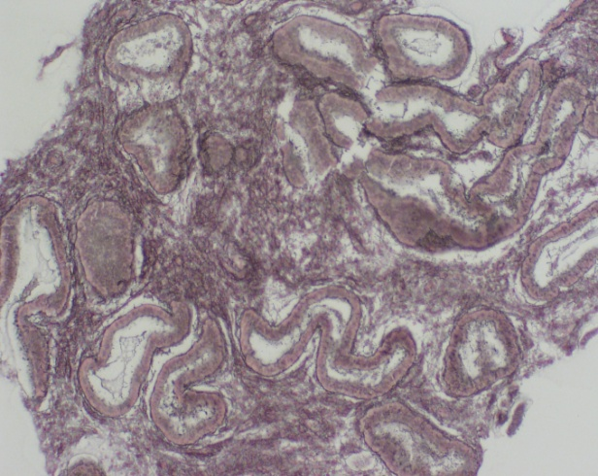
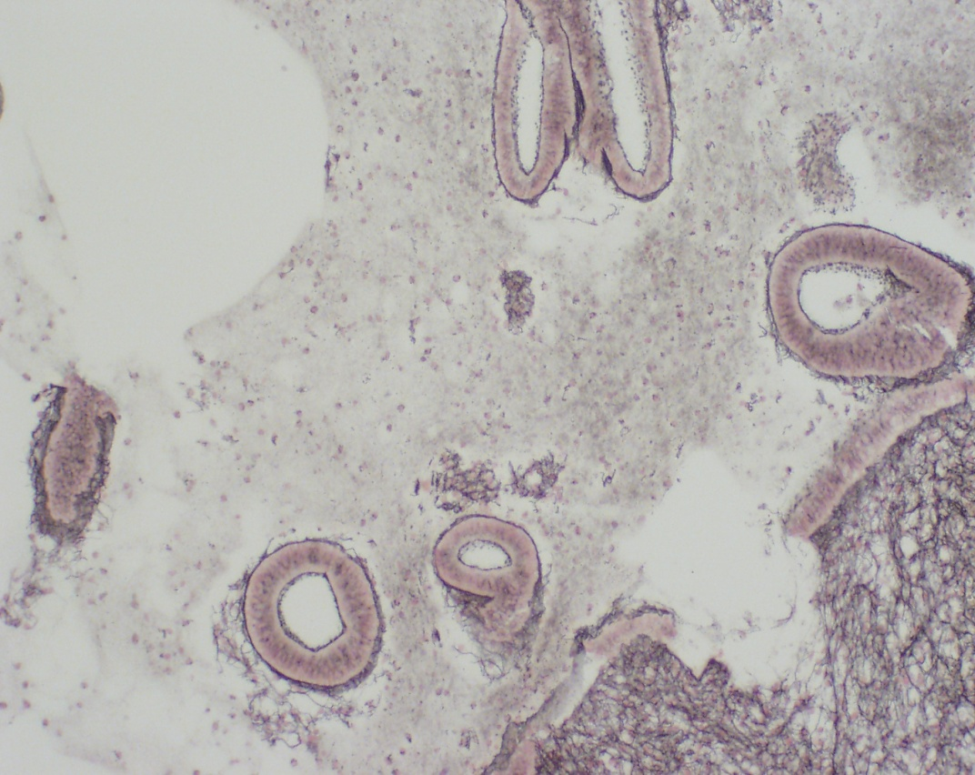
SPRMs and management of irregular bleeding on progestin only contraceptive regimen
Control
IUD-LNG

Slide 20
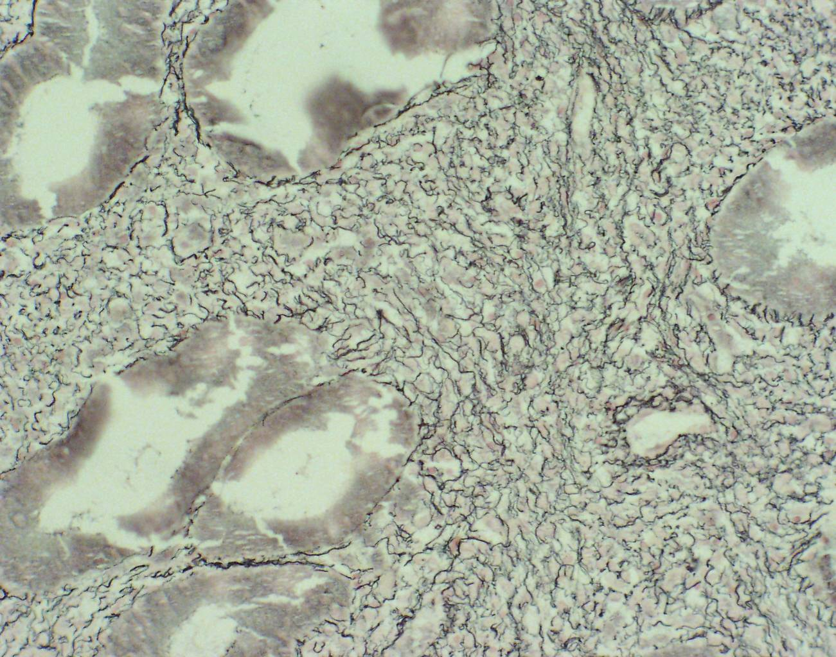
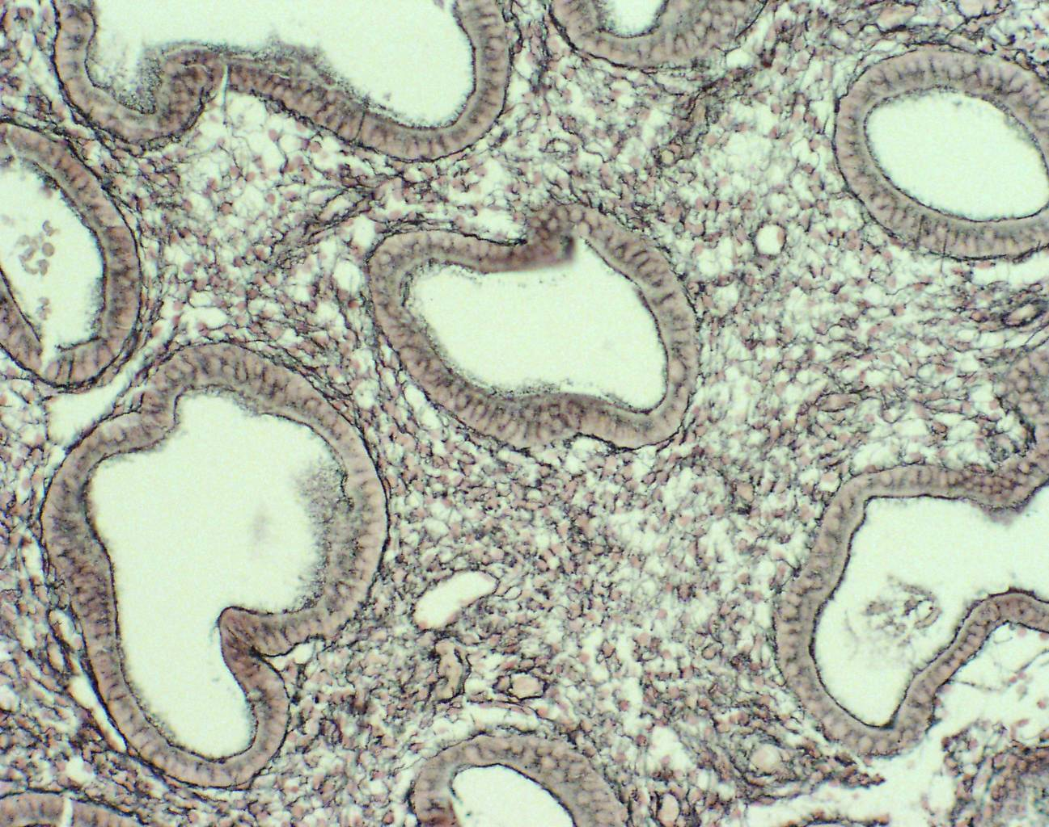
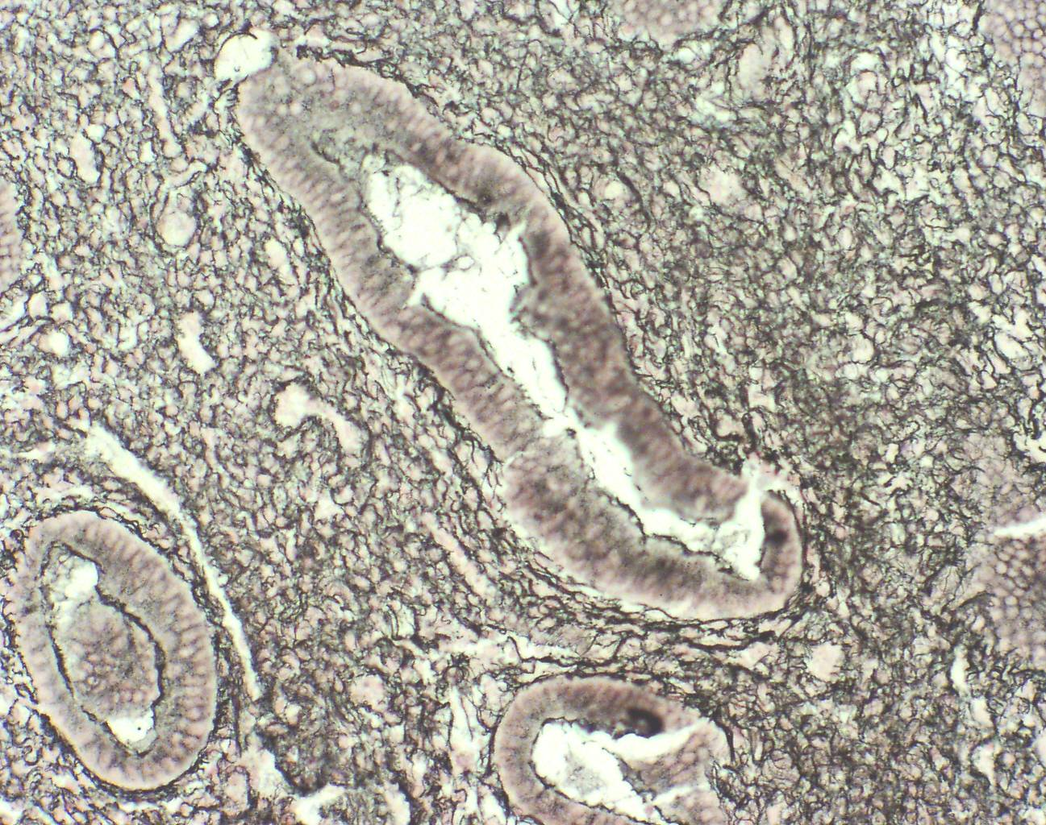
Endometrium and VA 2914 (2.5, 5, 10 mg)
Ravet S, Munaut C, Blacher S, Brichant G, Labied S, Beliard A, Chabbert-Buffet N, Bouchard P, Foidart JM, Pintiaux A.
J Clin Endocrinol Metab. 2008 Nov;93(11):4525-31.

Slide 21
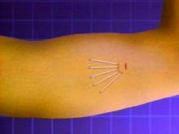
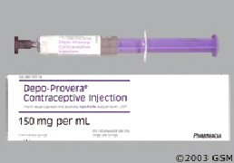

SPRMs and management of irregular bleeding on progestin only contraceptive regimen
Org 31710 : 150 mg 1x/month to women using desogestrel 75 µg/d (Gemzell Danielsson, 2002)
Mifepristone : 50 mg/month to women using the LNG implant ( Cheng, 2000)
Mifepristone : 25 mg/2 weeks for 3 months to women using depot MPA ( Jain, 2003)

Slide 22

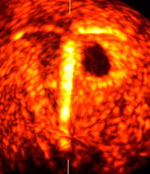
SPRMs and Devices

Slide 23
SPRMs and Devices
ZK 230211 releasing IUD tested in monkeys and in women ( Nayak, 2007 ; Heikinheimo, 2007)
VA 2914 releasing IUD tested in monkeys (Population Council)
VA 2914 vaginal ring for 3 months (Sitruk- Ware, 2005)

Slide 24
Clinical Aspects
Effects of the progesterone receptor modulator VA2914 in a continuous low dose on the hypothalamic-pituitary-ovarian axis and endometrium in normal women : a prospective, randomized, placebo-controlled trial.
Chabbert-Buffet N, Pintiaux-Kairis A, Bouchard P; VA2914 Study Group.
J Clin Endocrinol Metab. 2007 Sep;92(9):3582-9.

Slide 25
Ovulation inhibition– Bleeding pattern
 | Placebo (n=11) | 2.5mg (n=11) | 5mg (n=11) | 10mg (n=10)
Amenorrhea%
M1 | 0 | 27.3 | 63.3 | 80
M2 | 0 | 36.4 | 81.8 | 90
M3 | 0 | 18.2 | 81.8 | 90
Mean bleeding duration(day)
M1 | 5.6 | 4.8 | 5 | 3.9
M2 | 5.6 | 4.7 | 1.4 | 1.4
M3 | 6.4 | 4.2 | 1.25 | 0.3
 | Placebo (n=11) | 2.5mg (n=11) | 5mg (n=11) | 10mg (n=10)
Anovulation rate(versus placebo) | 0 | 9.1(NS) | 81.8 (p<0.001) | 80 (p<0.001)

Slide 26
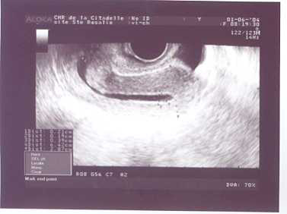
Ultrasonographic Aspects

Slide 27
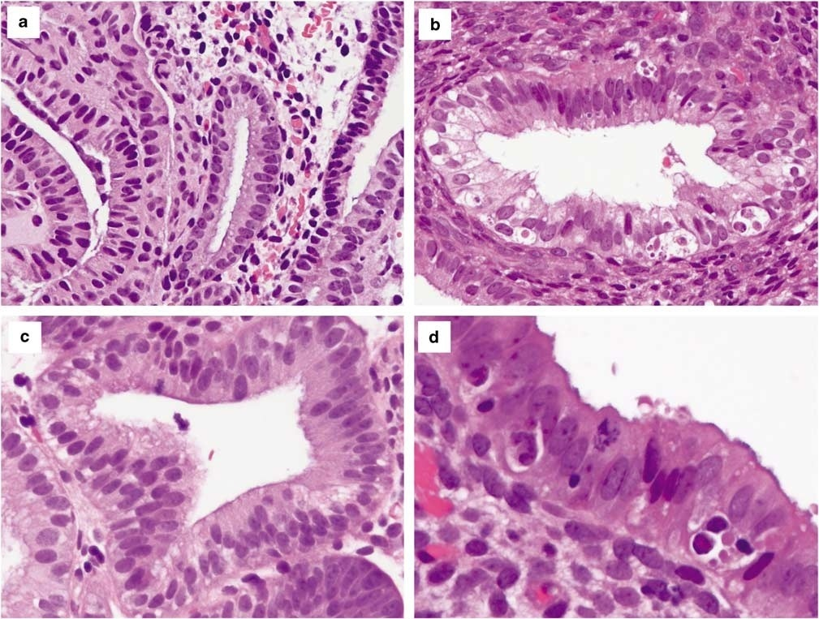
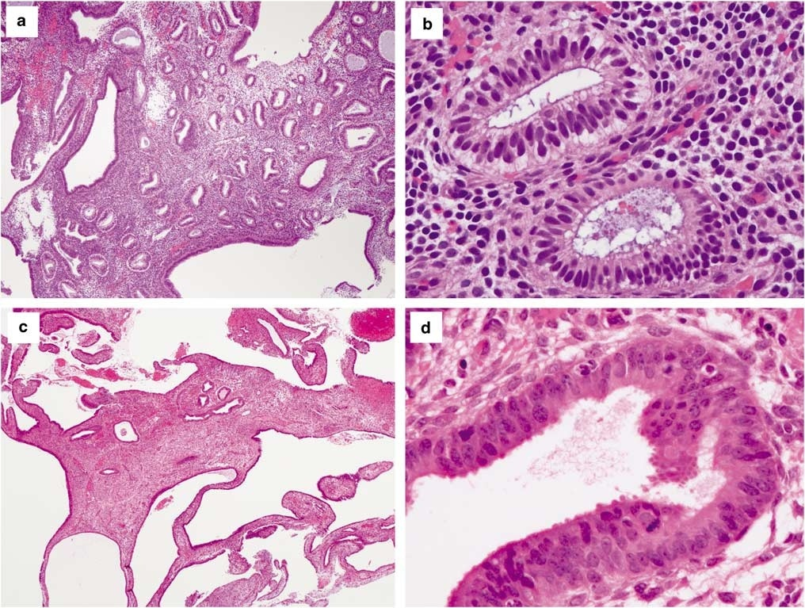
Histologic Aspects
Mutter, 2008

Slide 28
PRM - Associated Endometrial Changes
Dyssynchronous growth between glands and stroma
Interspersed cysts throughout all the endometrium
Glands showing non physiological combination of inactivity, secretory changes, mitosis and apoptosis
Fibrous stroma with mitotic figures
Vascular aspects (thick wall vessels, anastomosing capillary network, ectatic stromal blood vessels)

Slide 29
Conclusions
SPRM limited actually to short term use
Ideal SPRM : reduced antiglucocorticoid properties
Intermittent therapy ?
Long term endometrial safety ?

